Slide 1
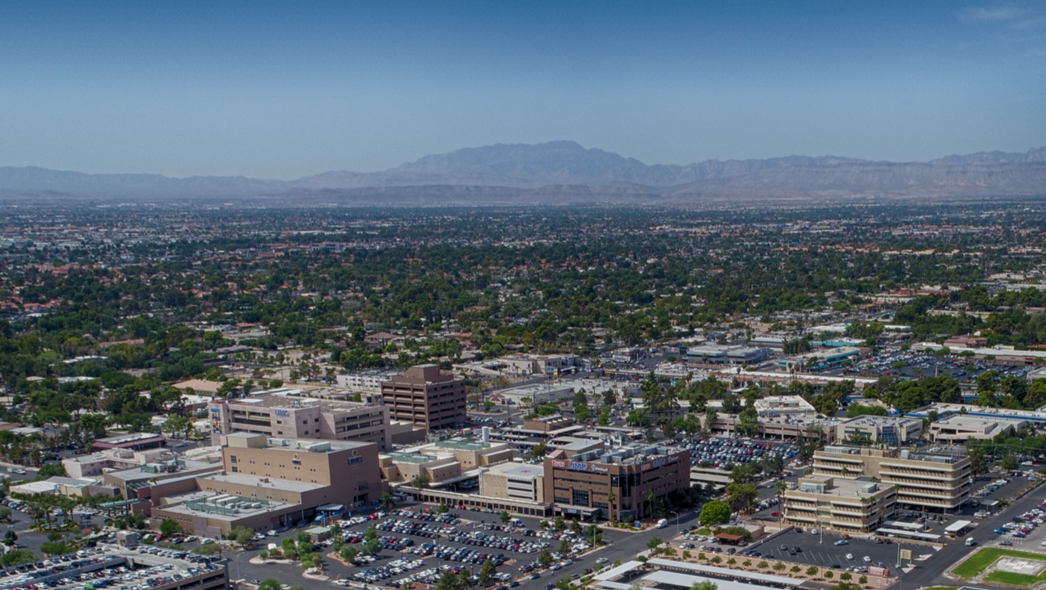

Charleston 2050
special area plan
R-68-2025 / 25-0179-DIR1
ItemS 36 / 48
CITY COUNCIL
NOVEMBER 5, 2025

Slide 2
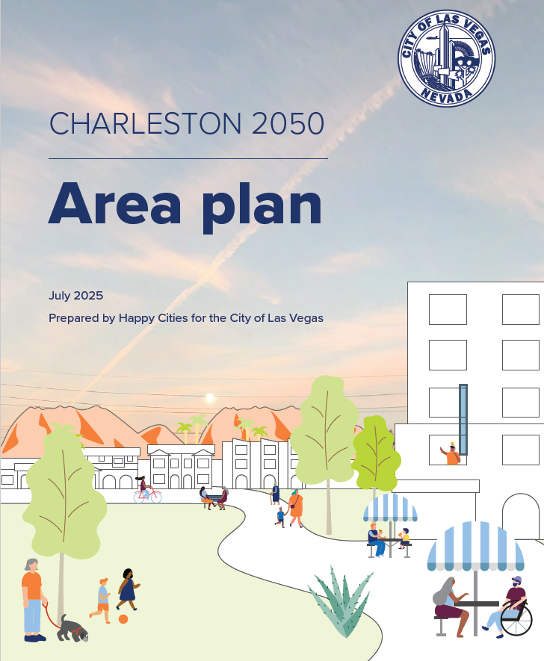
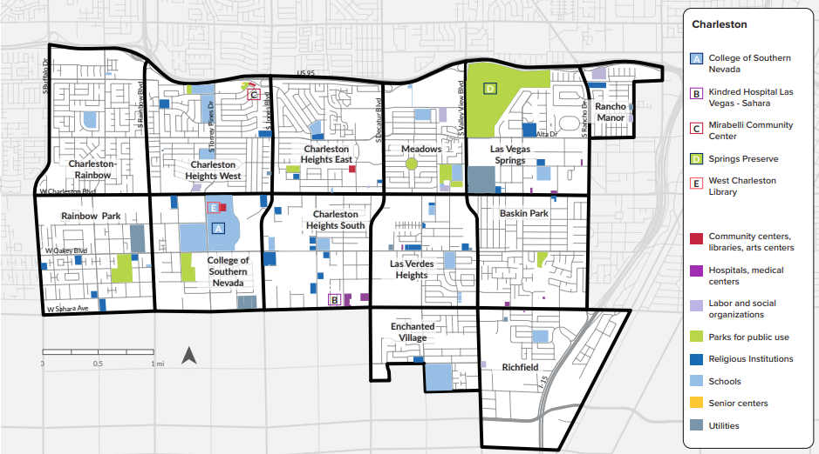
Charleston special area plan

Slide 3
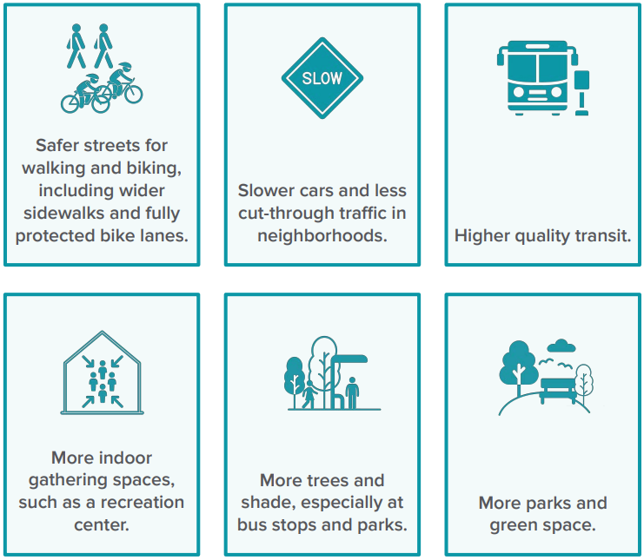
Outreach
Community Surveys and outreach 2024-25
  Safer streets for walking and biking
  Higher quality public transit
  More indoor public gathering spaces
  More trees, shade, and parks
  Slower cars, less cut-though traffic in neighborhoods
Charleston’s diverse population, important destinations, and transit infrastructure offer significant potential to cement a healthy, livable community with a strong sense of community pride and belonging.

Slide 4

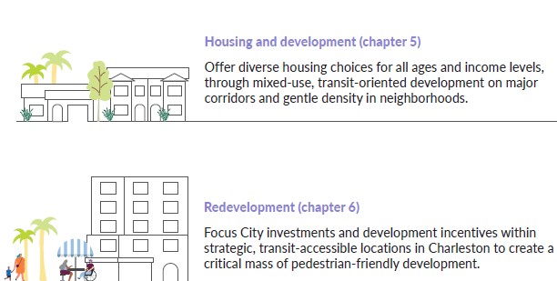
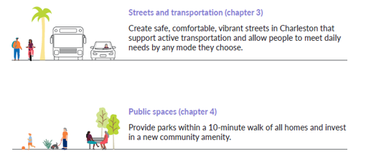
Four Areas of action

Slide 5
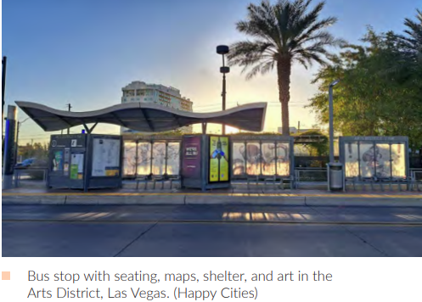
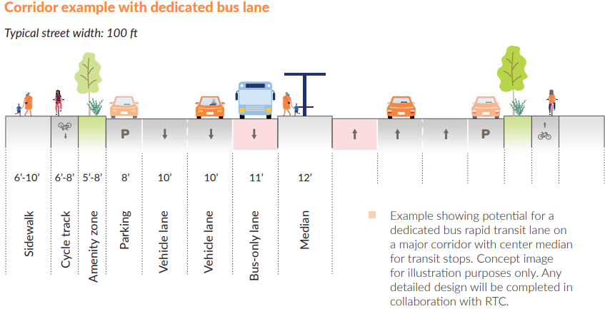
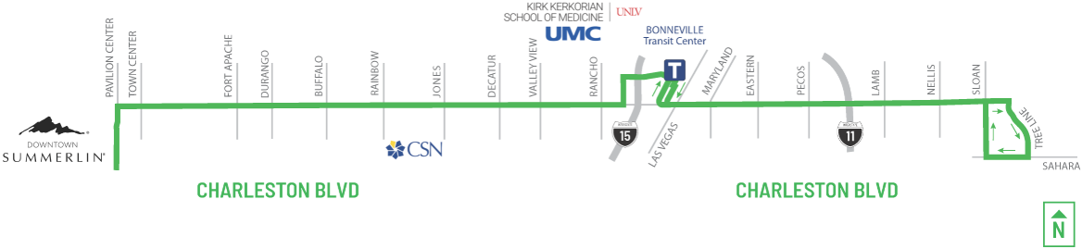

Streets & Transportation
https://charlestonblvd.com/

Slide 6
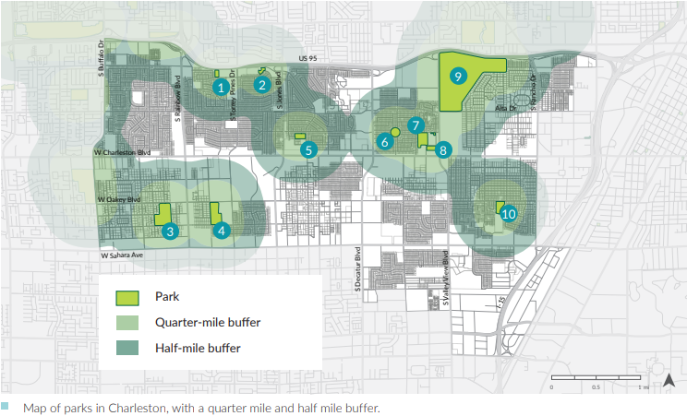

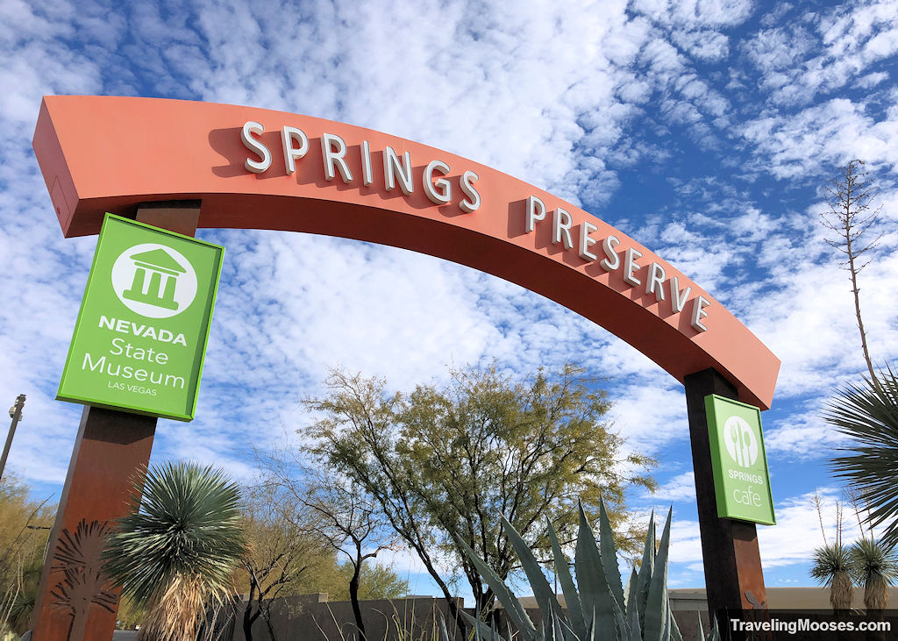
Public spaces

Slide 7
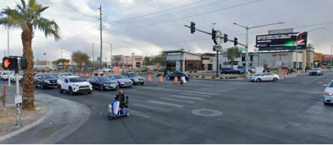
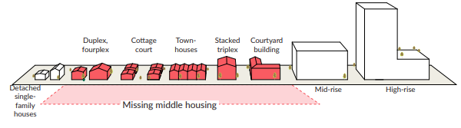
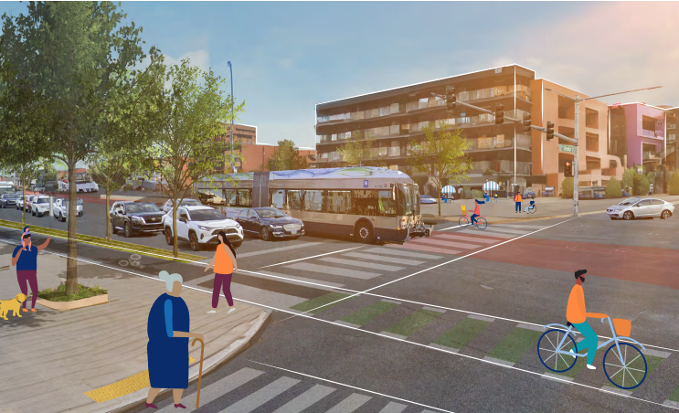
Housing & DEVELOPMENT
Notes:
More affordable housing options and protect low-income households from displacement.
Provide incentives for affordable housing
Protect affordable housing stock
Explore creating a community land trust (CLT)
Consider a land-value capture tax

Slide 8
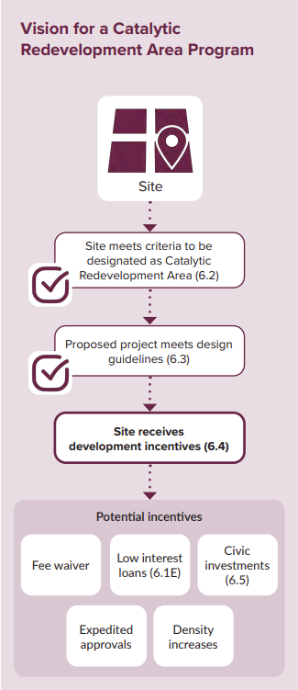
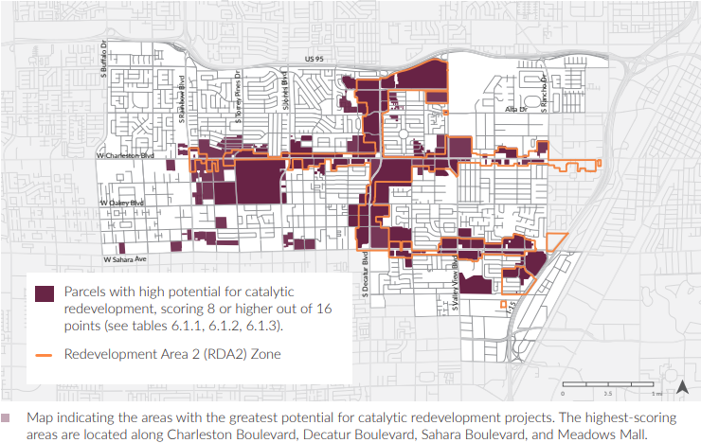
Redevelopment
Notes:
Focus investments and development incentives within strategic, transit-accessible locations in Charleston to create a critical mass of pedestrian-friendly development.

Slide 9
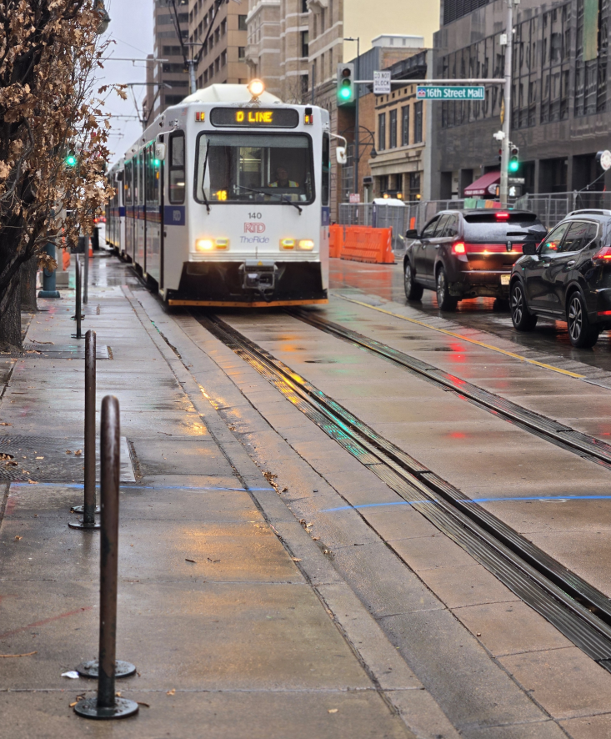
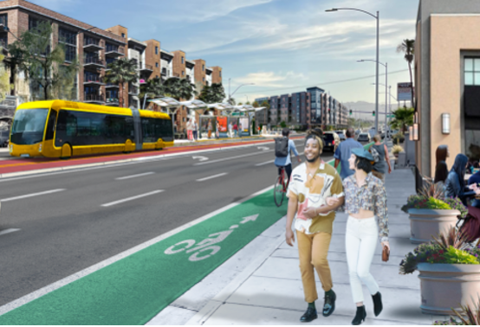
Next steps
TOD-O Zoning Standards (25-0201-TXT1)
  Building dimensional standards
  Mixed uses
  Pedestrian space
  Parking standards
Charleston Alternatives Analysis / TOD planning
Title 19 parking study
TOD and Housing Incentives
  SB 28 (2025) – NRS 278C Tax increment areas for TOD
  AB 540 (2025) – Attainable housing incentives
Urban Forestry / Tree Ordinance

Slide 10
