Slide 1
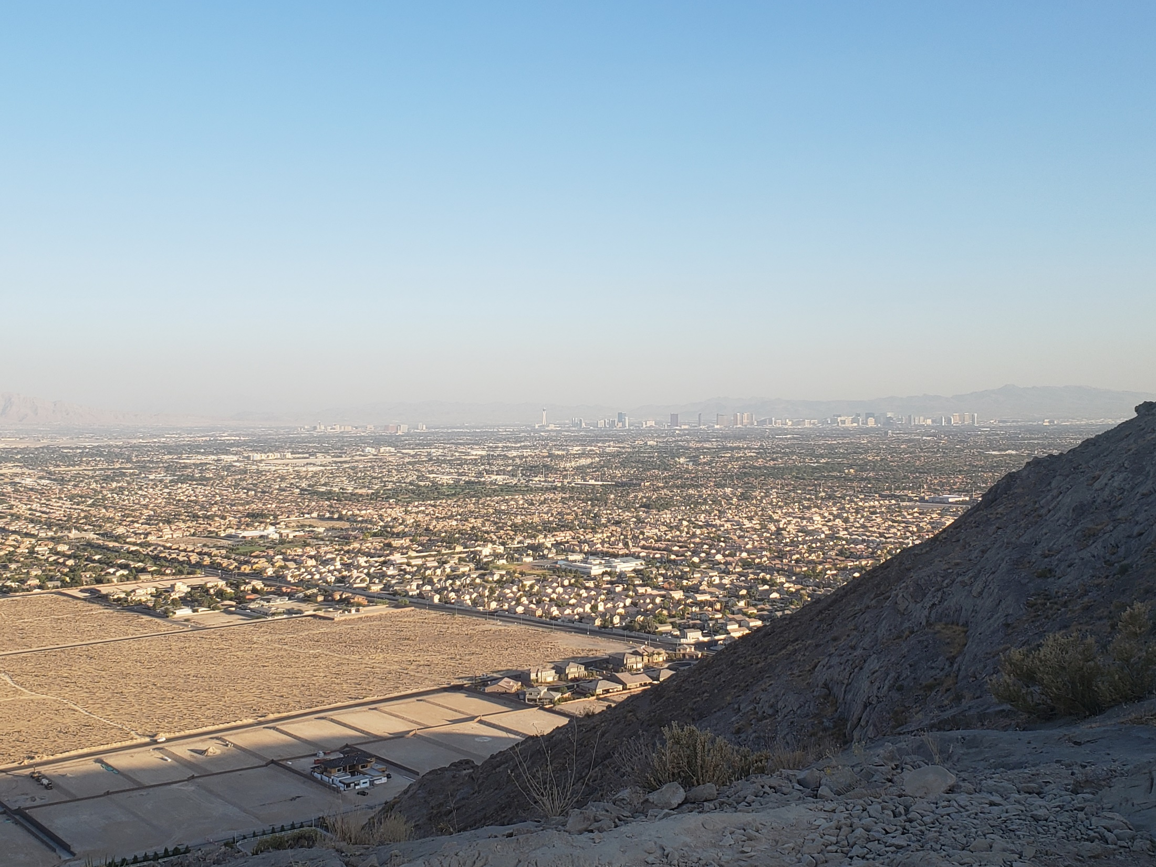

2050 Master Plan
Neighborhood meetings
March 16, 20, & 22, 2021
21-0029-gpa1

Slide 2
Welcome – and Thank you
For our audience here at City Hall:
  Thank you for maintaining social distancing and continuing to wear your mask
  Write down any questions and provide them to City staff at the front
  Questions and answers will be taken at the end of each presentation
For our viewers online and on KCLV:
  Submit your questions to socialmedia@lasvegasnevada.gov
If we run out of time and we don’t answer your question:
  Please contact a staff member at the conclusion of the meeting – we want document your question and provide a response
  Emailed questions will be responded to over the next week

Slide 3
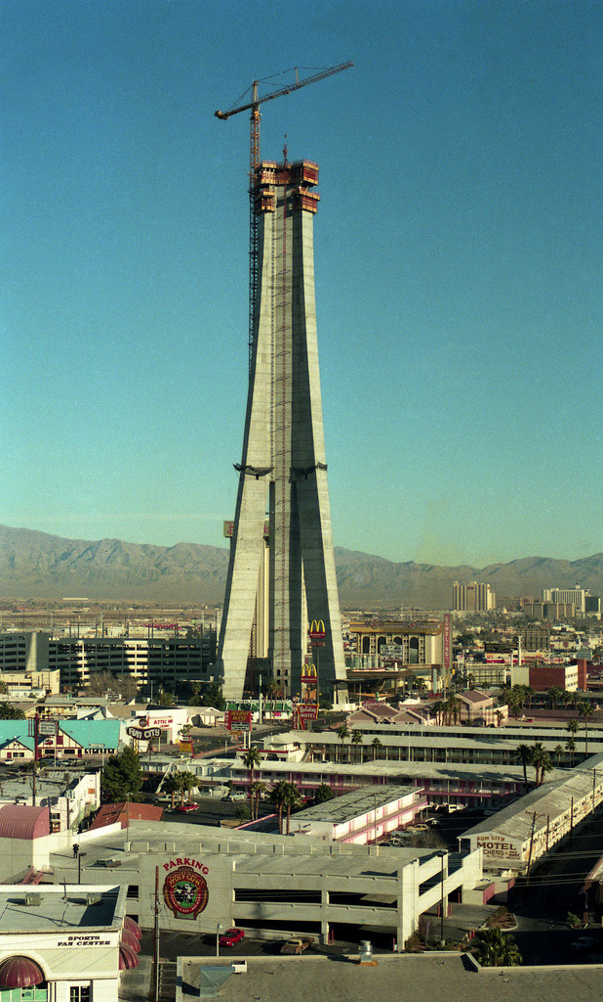
Today’s agenda
Adoption of the 2050 Master Plan
  What is this plan?
  Why is the City doing it?
  What have we done so far?
  How does the plan impact me, my family, or my business?
  What happens next?
An overview of the plan
Land use changes
Top of the hour: Imagine LV Parks

Slide 4
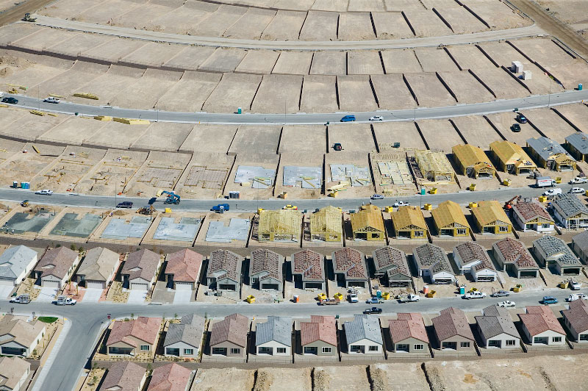
A few common questions we’ve received
What is a master plan?
What’s the difference between land use and zoning?
What’s my land use? What’s my zoning?
Are you taking our property?
Does this involve eminent domain?
Does changing my land use affect the value of my property?
Can’t we just stop people from moving here?

Slide 5
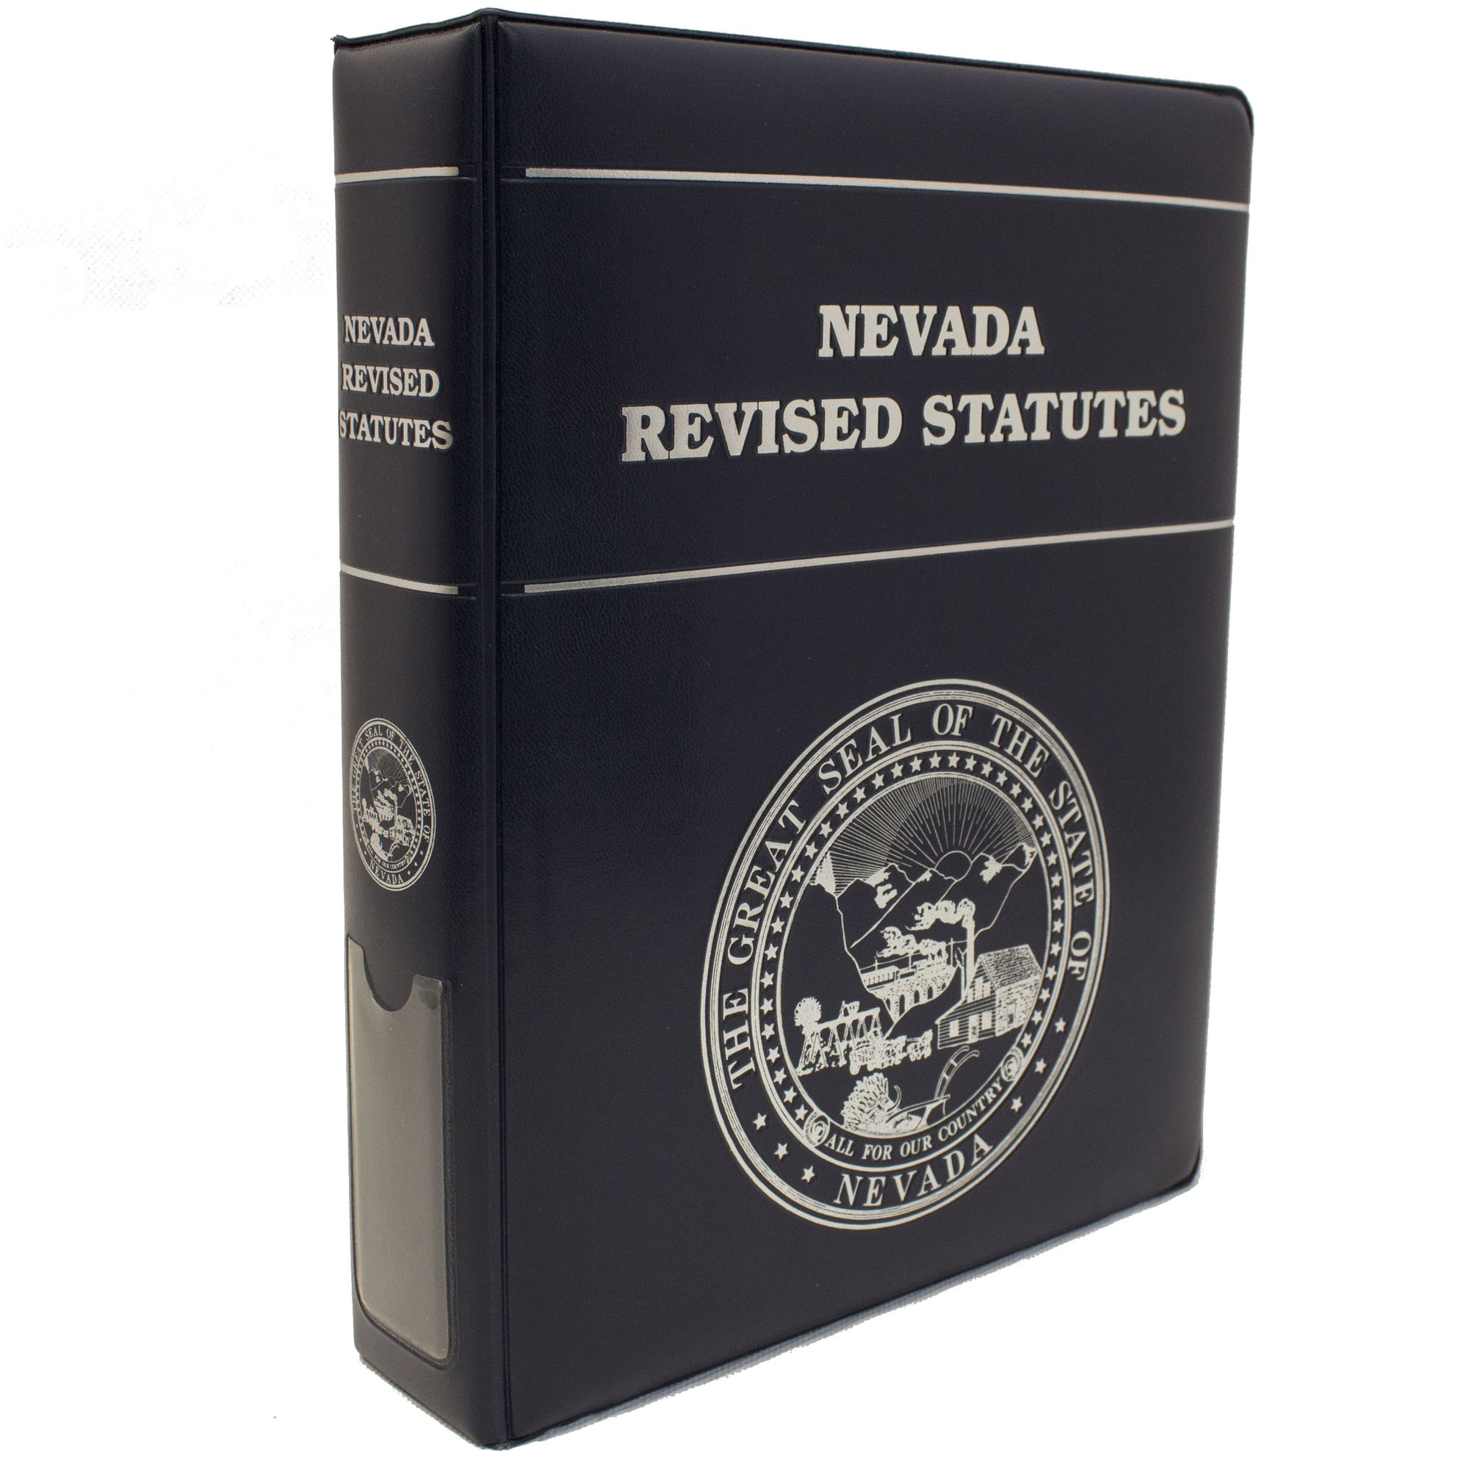
Master Plans
A “master plan” is a long-term comprehensive plan for the physical development of the city.
  Prepares for change over time
  Guides decisions of the city
  Identifies current issues, community needs, and establishes future goals
  Uses community input to determine priorities
State and local laws give the City Council and Planning Commission the authority to plan and divide (or “zone”) land for different types of uses

Slide 6
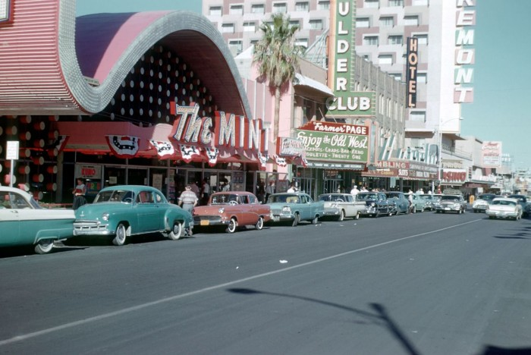

Slide 8
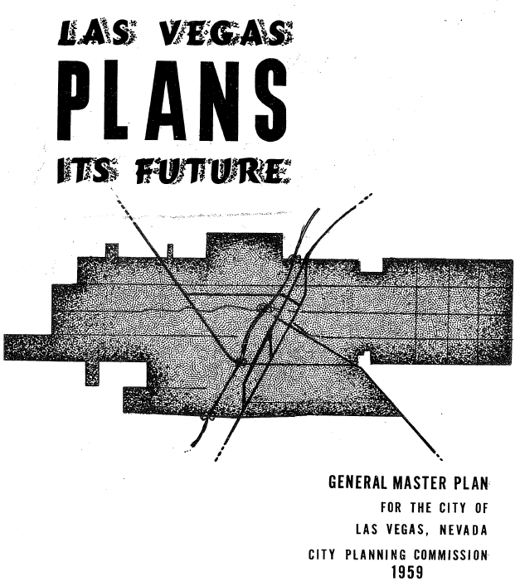
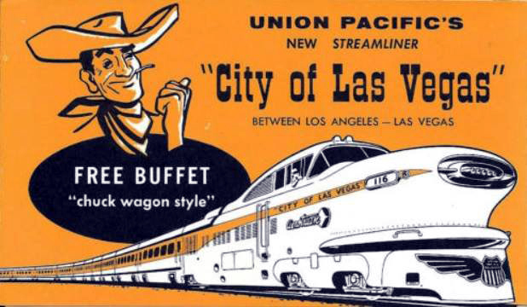

Slide 9
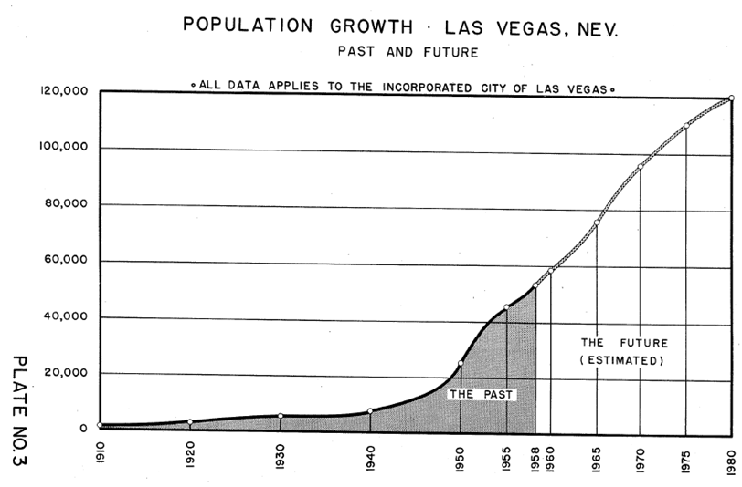
1959: projected population

Slide 10
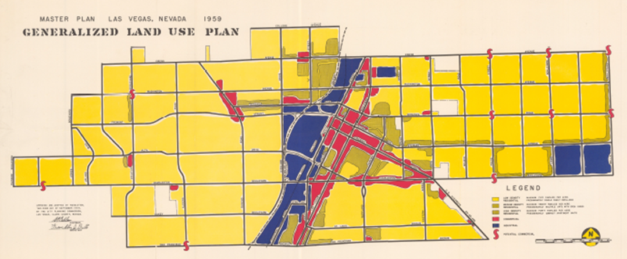
1959 general master plan
“The Planning Commission believes it has developed a plan which is truly comprehensive and touches every important physical and economic phase of the community development.”
- Planning Director Franklin J Bills – Letter to Mayor Gragson and Board of City Commissioners

Slide 11
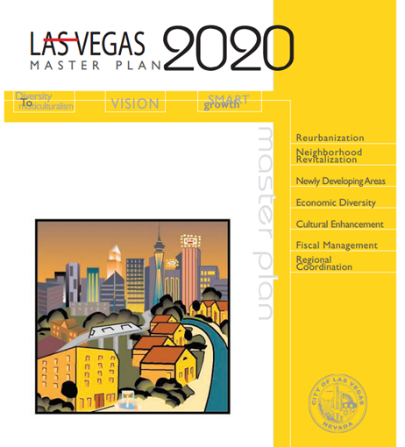
las vegas master plan 2020
2000-2013: City of Las Vegas Master Plan 2020 was adopted by the Planning Commission, as well as subsequent master plan updates.

Slide 12
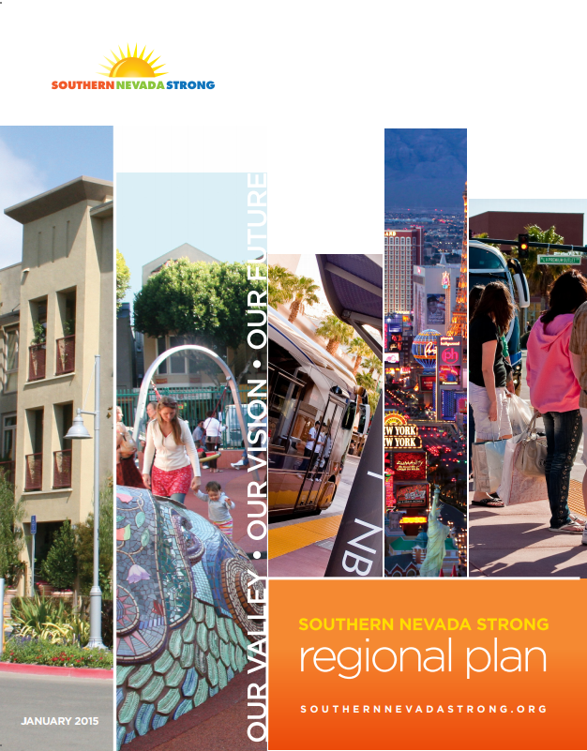
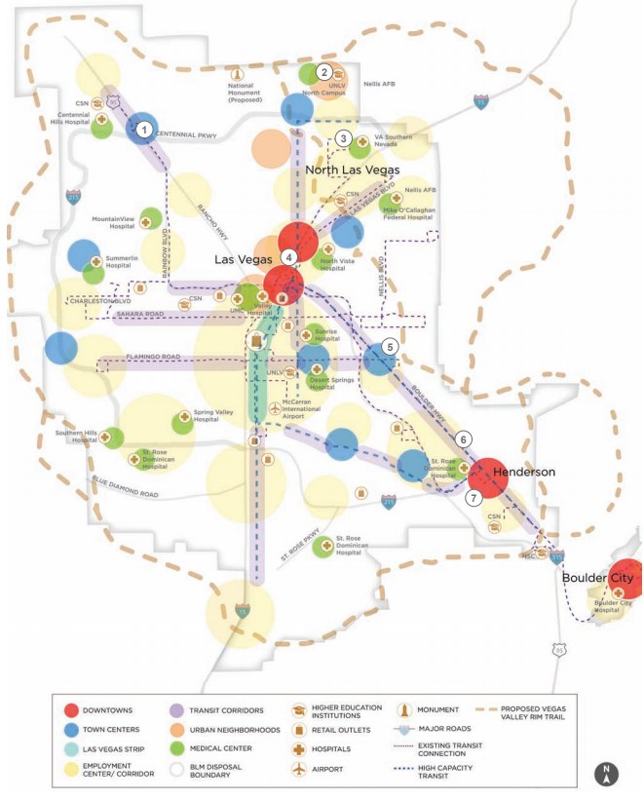
Regional planning efforts

Slide 13
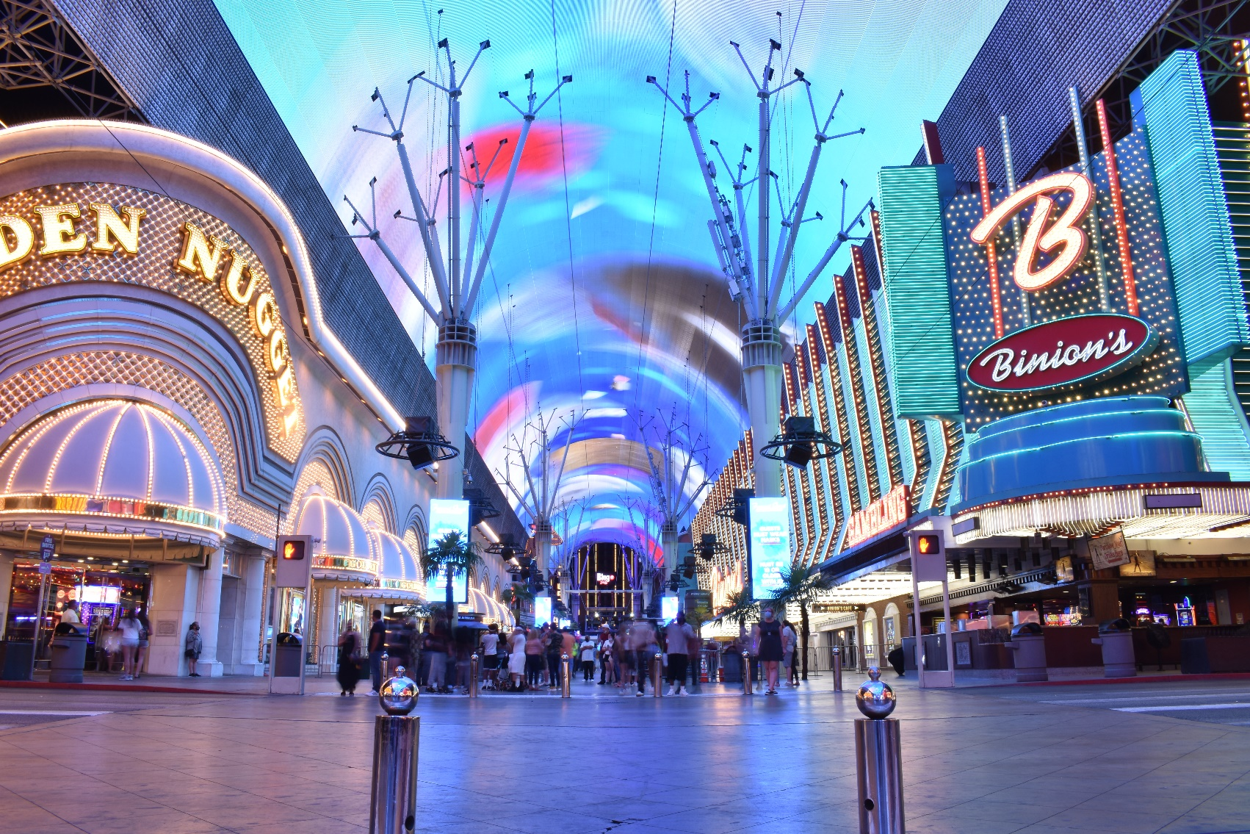
Preparing for a new plan
2017: The Planning Commission determined that the goals, objectives, and policies of the City of Las Vegas Master Plan 2020 were largely met.
  Population growth: 485,000 to 650,000
  Economic challenges from Great Recession
  Demographic, socio-economic, and land use change
  Need for new infrastructure and services
City Council directs city staff to develop a new master plan. (R-32-2017)
2018: SmithGroup team to assist City staff with a public outreach campaign and plan development activities

Slide 14
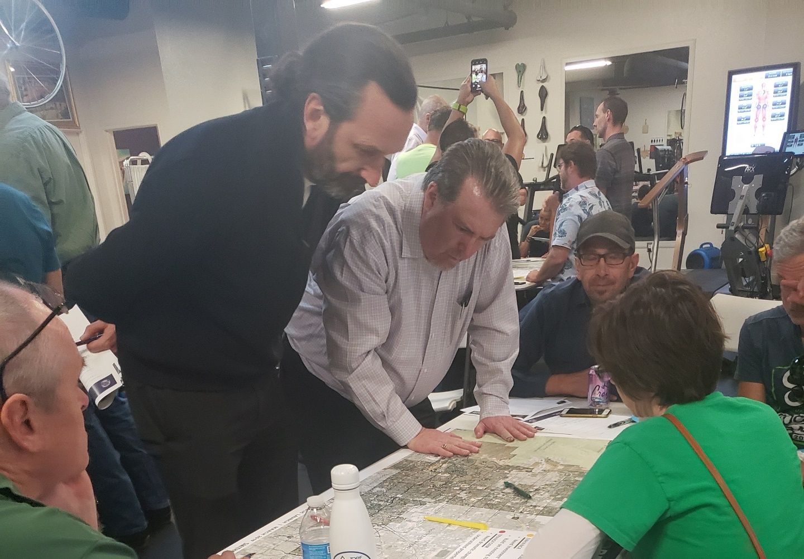
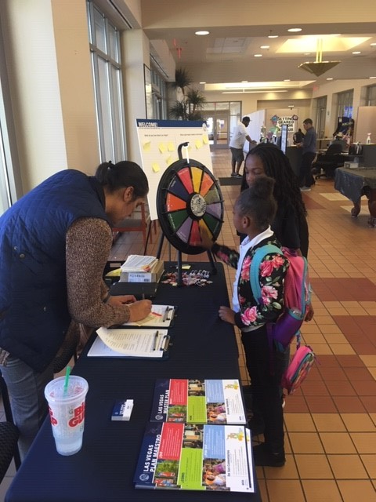
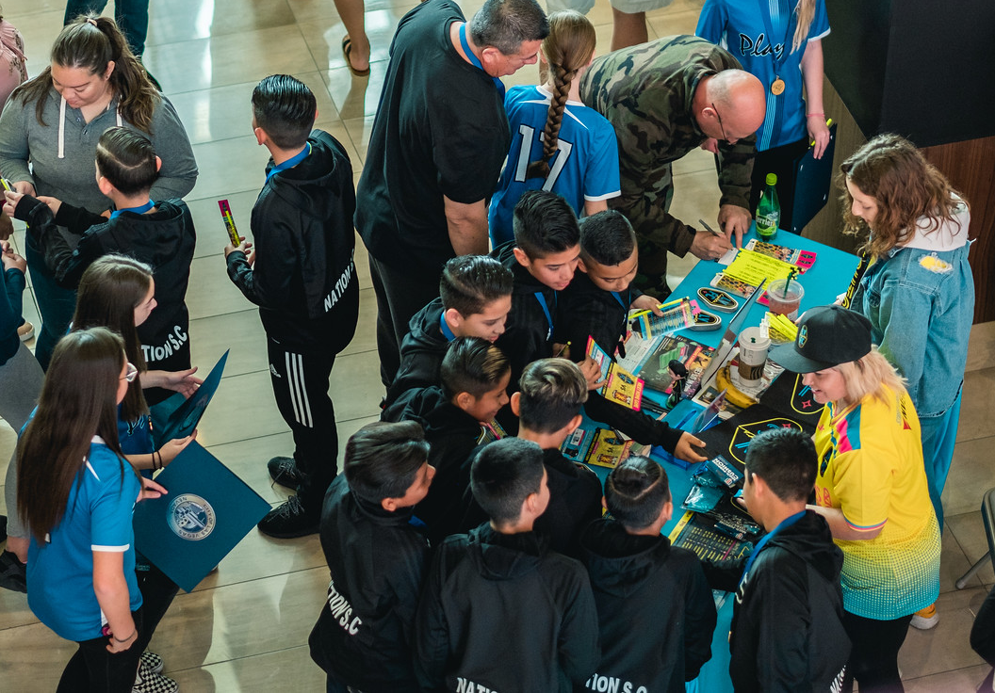
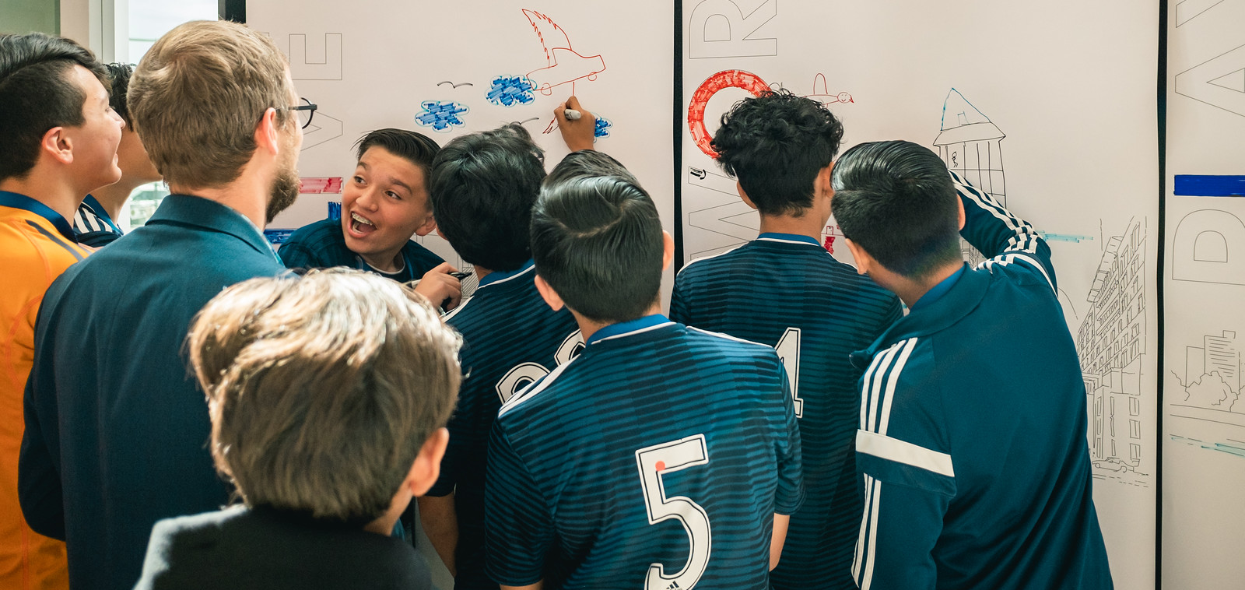
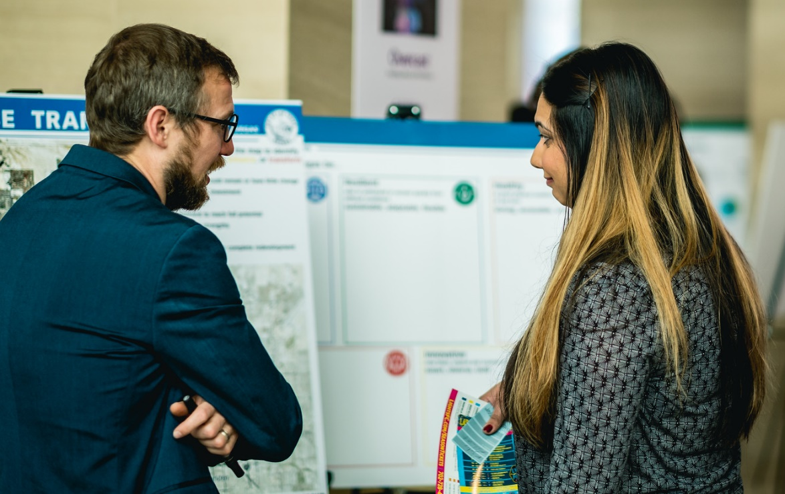
Community outreach and input
6,000 people reached
  3,400 individual input responses
  1,700 surveys, equally distributed across all wards
  68 community events in all wards
  28 stakeholder meetings in all wards
  Citizen’s Advisory Committee
Notes:
Staff/department head listening sessions (August)
Agency listening sessions (December)
Citizens Advisory Committee (monthly)
Public visioning sessions (March/April)
Open houses
Presentations
Online feedback
Survey (results pending)

Slide 15
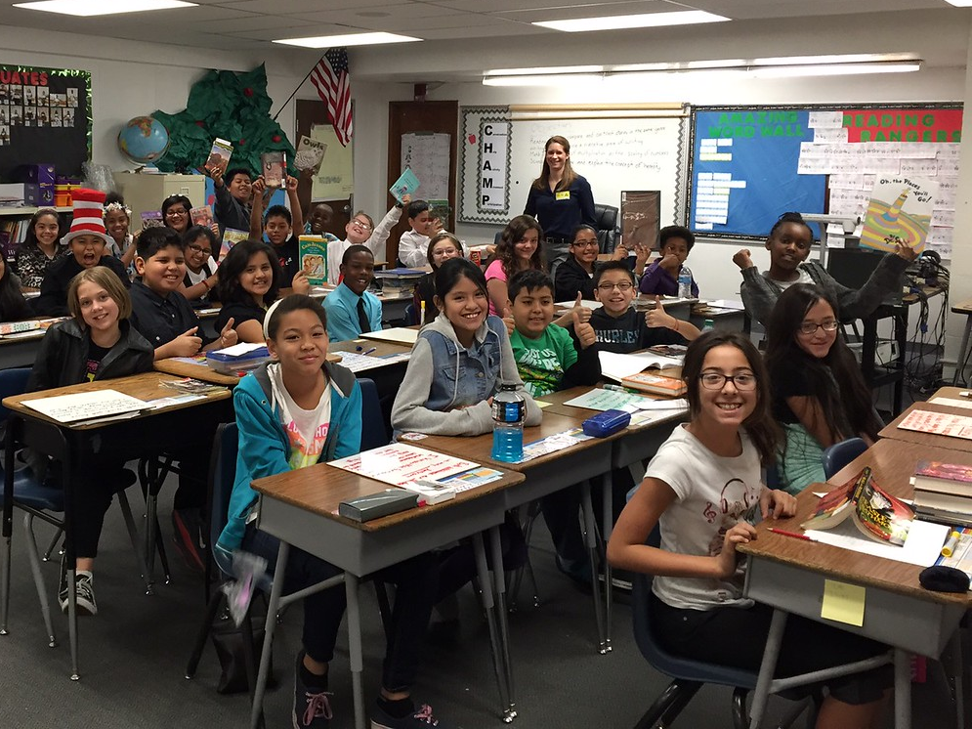

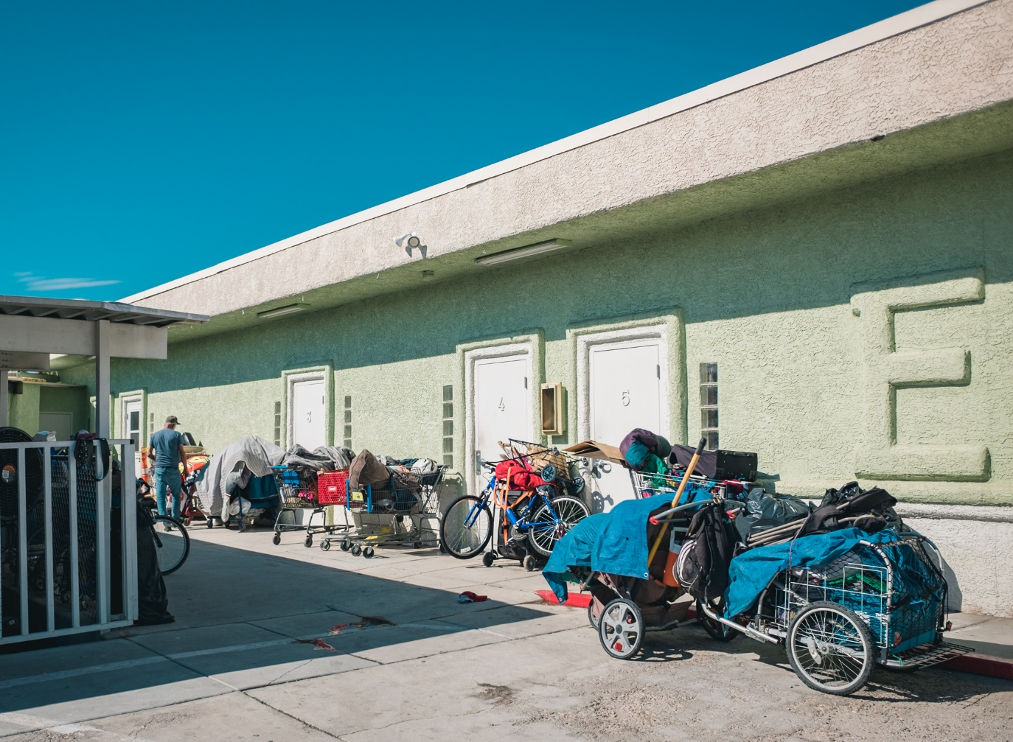
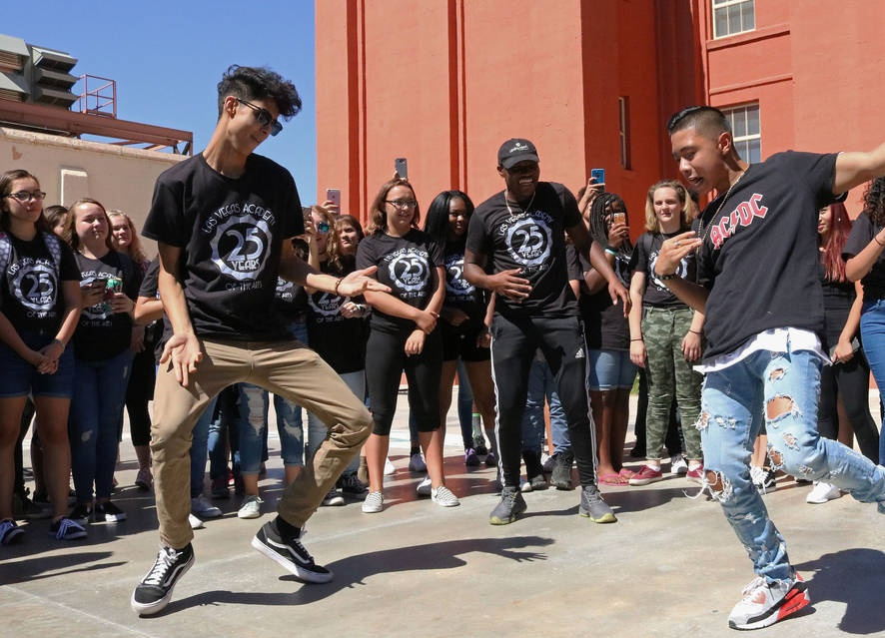
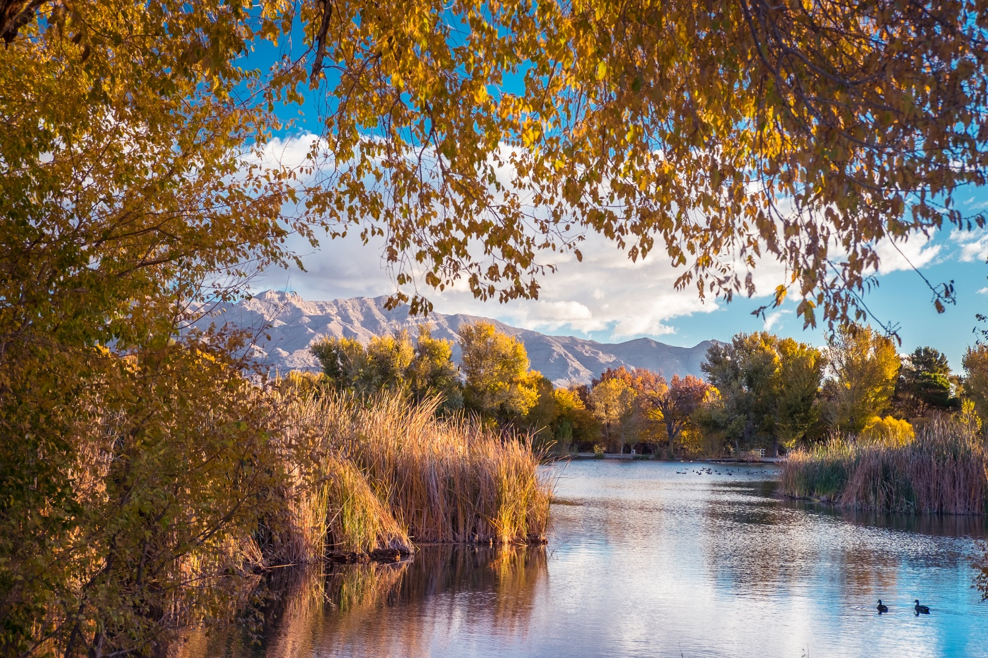
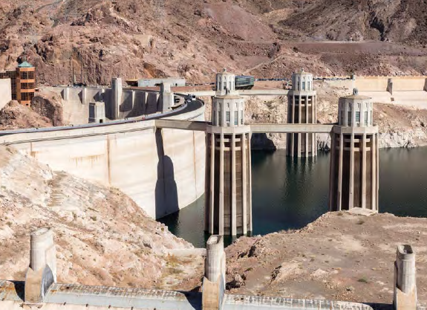
What we heard: top challenges
Crime/safety
homelessness
education
water availability
Drought
Open space
preservation
Notes:
These issues aren’t under direct city control
How to address “yes, education isn’t directly in our control, but the vitality of our community is directly tied to education”
Youth department
All quality of life: guiding principles are the undergirding of the whole plan to respond to these issues
Land use can’t solve everything, but…

Slide 16
SOUTHERN NEVADA POPULATION

Slide 17
IN 2050, LAS VEGAS WILL likely HAVE:
600
New LVMPD Officers
2,500
New Teachers
30
New CCSD Schools
450
New Public Safety Employees
1,100
New City Employees
300,000+
New Residents
  And at least:
100,000+
New Housing Units in the City
300,000+ new residents
  A total city population of approximately 900,000+
  A total regional population of 3 million (in line with UNLV estimates
100,000+ new housing units in the city
  550,000+ total housing units in the region
72 million square feet of new commercial space
9,500+ acres of new parks needed
  Tule Springs National Monument included
88,000 acre feet of water
  300,000 allotted to SNWA + return flow credit
At least 600 new LVMPD officers, add XXX new teachers, XXX new city employees
  A total city population of approximately 900,000+
  A total regional population of 3 million (in line with UNLV estimates)
  550,000+ total housing units in the region
72 million
Square Feet of New Commercial Space
9,500+
Acres of New Parks Needed
  Tule Springs National Monument included

Slide 18
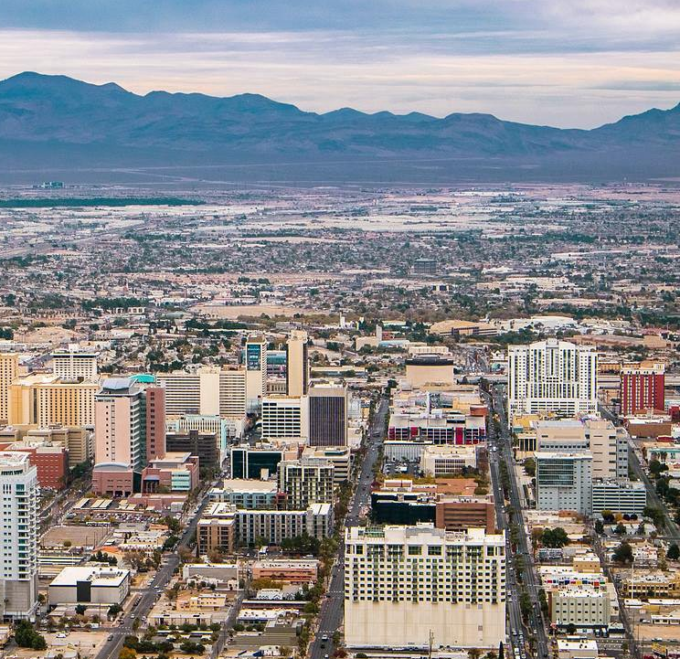
A vision for change
Las Vegas 2050 master plan
The City of Las Vegas will be A leader in resilient, Healthy cities - leveraging the pioneering innovative spirit of its residents to provide equitable access to services, Education, and jobs in the new economy.
Las Vegas in 2050 will be…
Bold
Innovative
Iconic
Working
Smart
Accessible
Collaborative
Notes:
Bold
Innovative
Iconic
Working
Smart
Accessible
Collaborative

Slide 19





Guiding principles
The foundation of GOALS, KEY actions, and strategies
EQUITABLE
inclusive, fair, welcoming
RESILIENT
sustainable, adaptable, flexible
HEALTHY
strong, accessible, well
LIVABLE
unique, complete, enjoyable
INNOVATIVE
smart, diverse, bold
Measure success
Weigh recommendations
Foster community-driven implementation
Improve quality of life for all residents

Slide 20
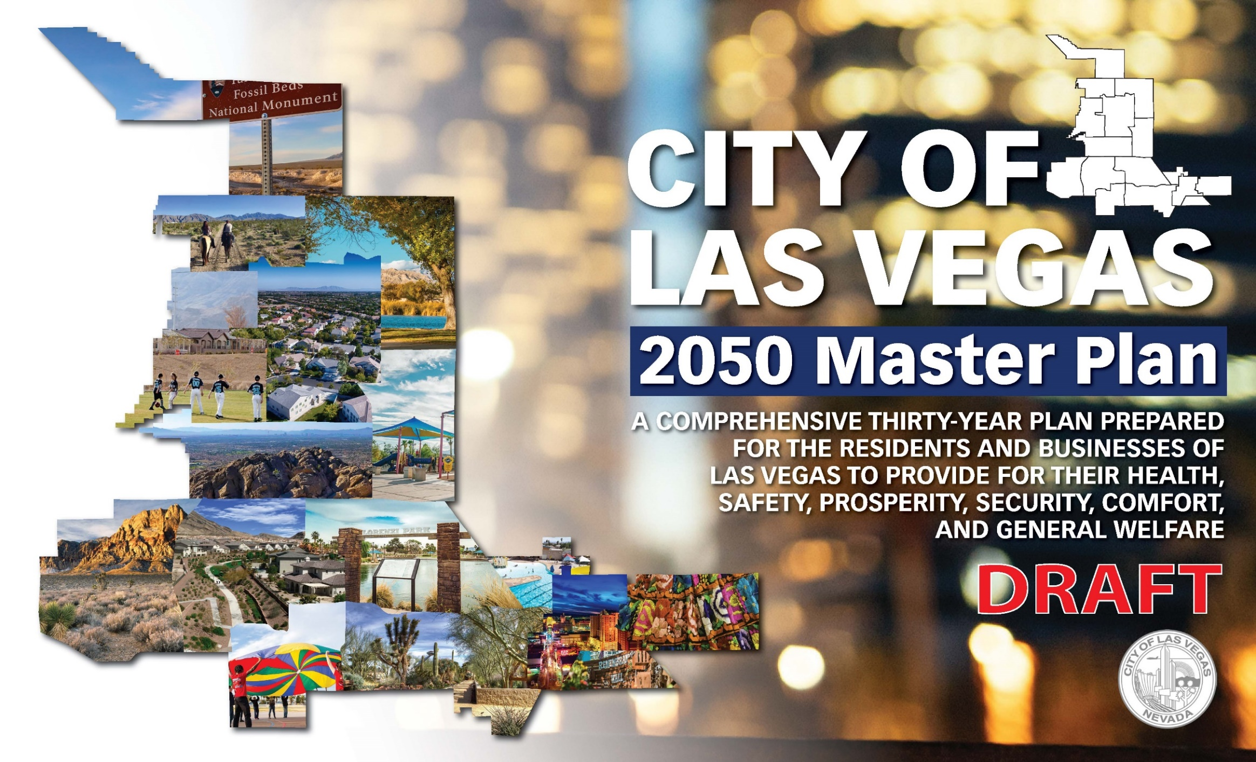
Progress continues
2019-2020: Master Plan under development
  August 2019: Developed goals prioritized and supported by public
  Draft developed
September 2020: Planning Commission Workshop
October-November 2020: revisions

Slide 21
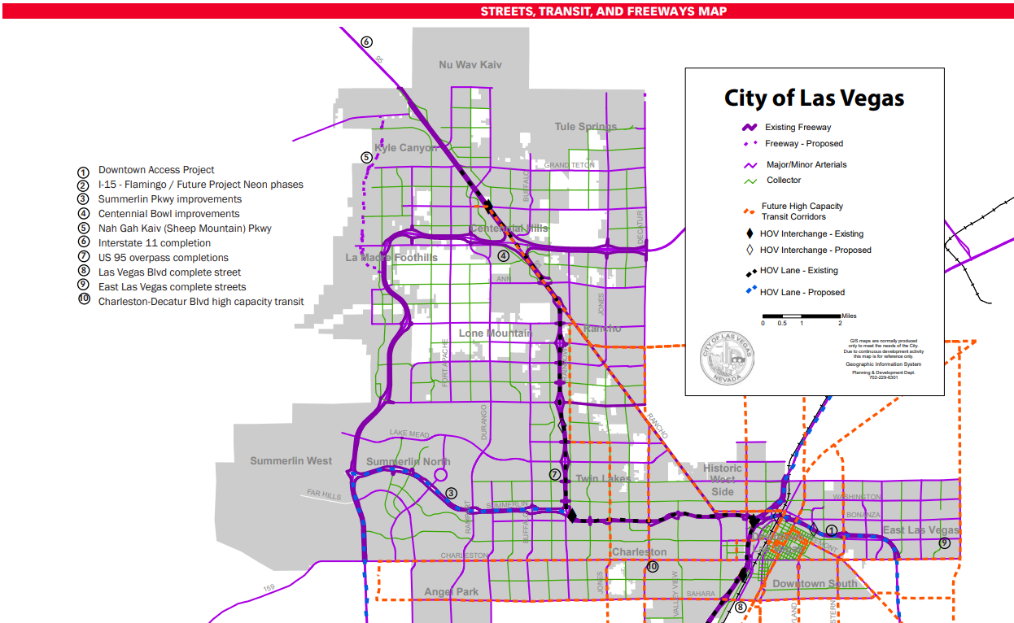
AN OVERVIEW OF THE plan
The 2050 Master Plan provides:
  Direction and practical guidelines for future development
  Implementation-focused recommendations adaptable to change
Overview of Plan and Chapters
  Areas of the City
  Land Use placetypes and 2050 General Plan
  Environment
  Economy and Education
  Systems and Services
  Implementation

Slide 22
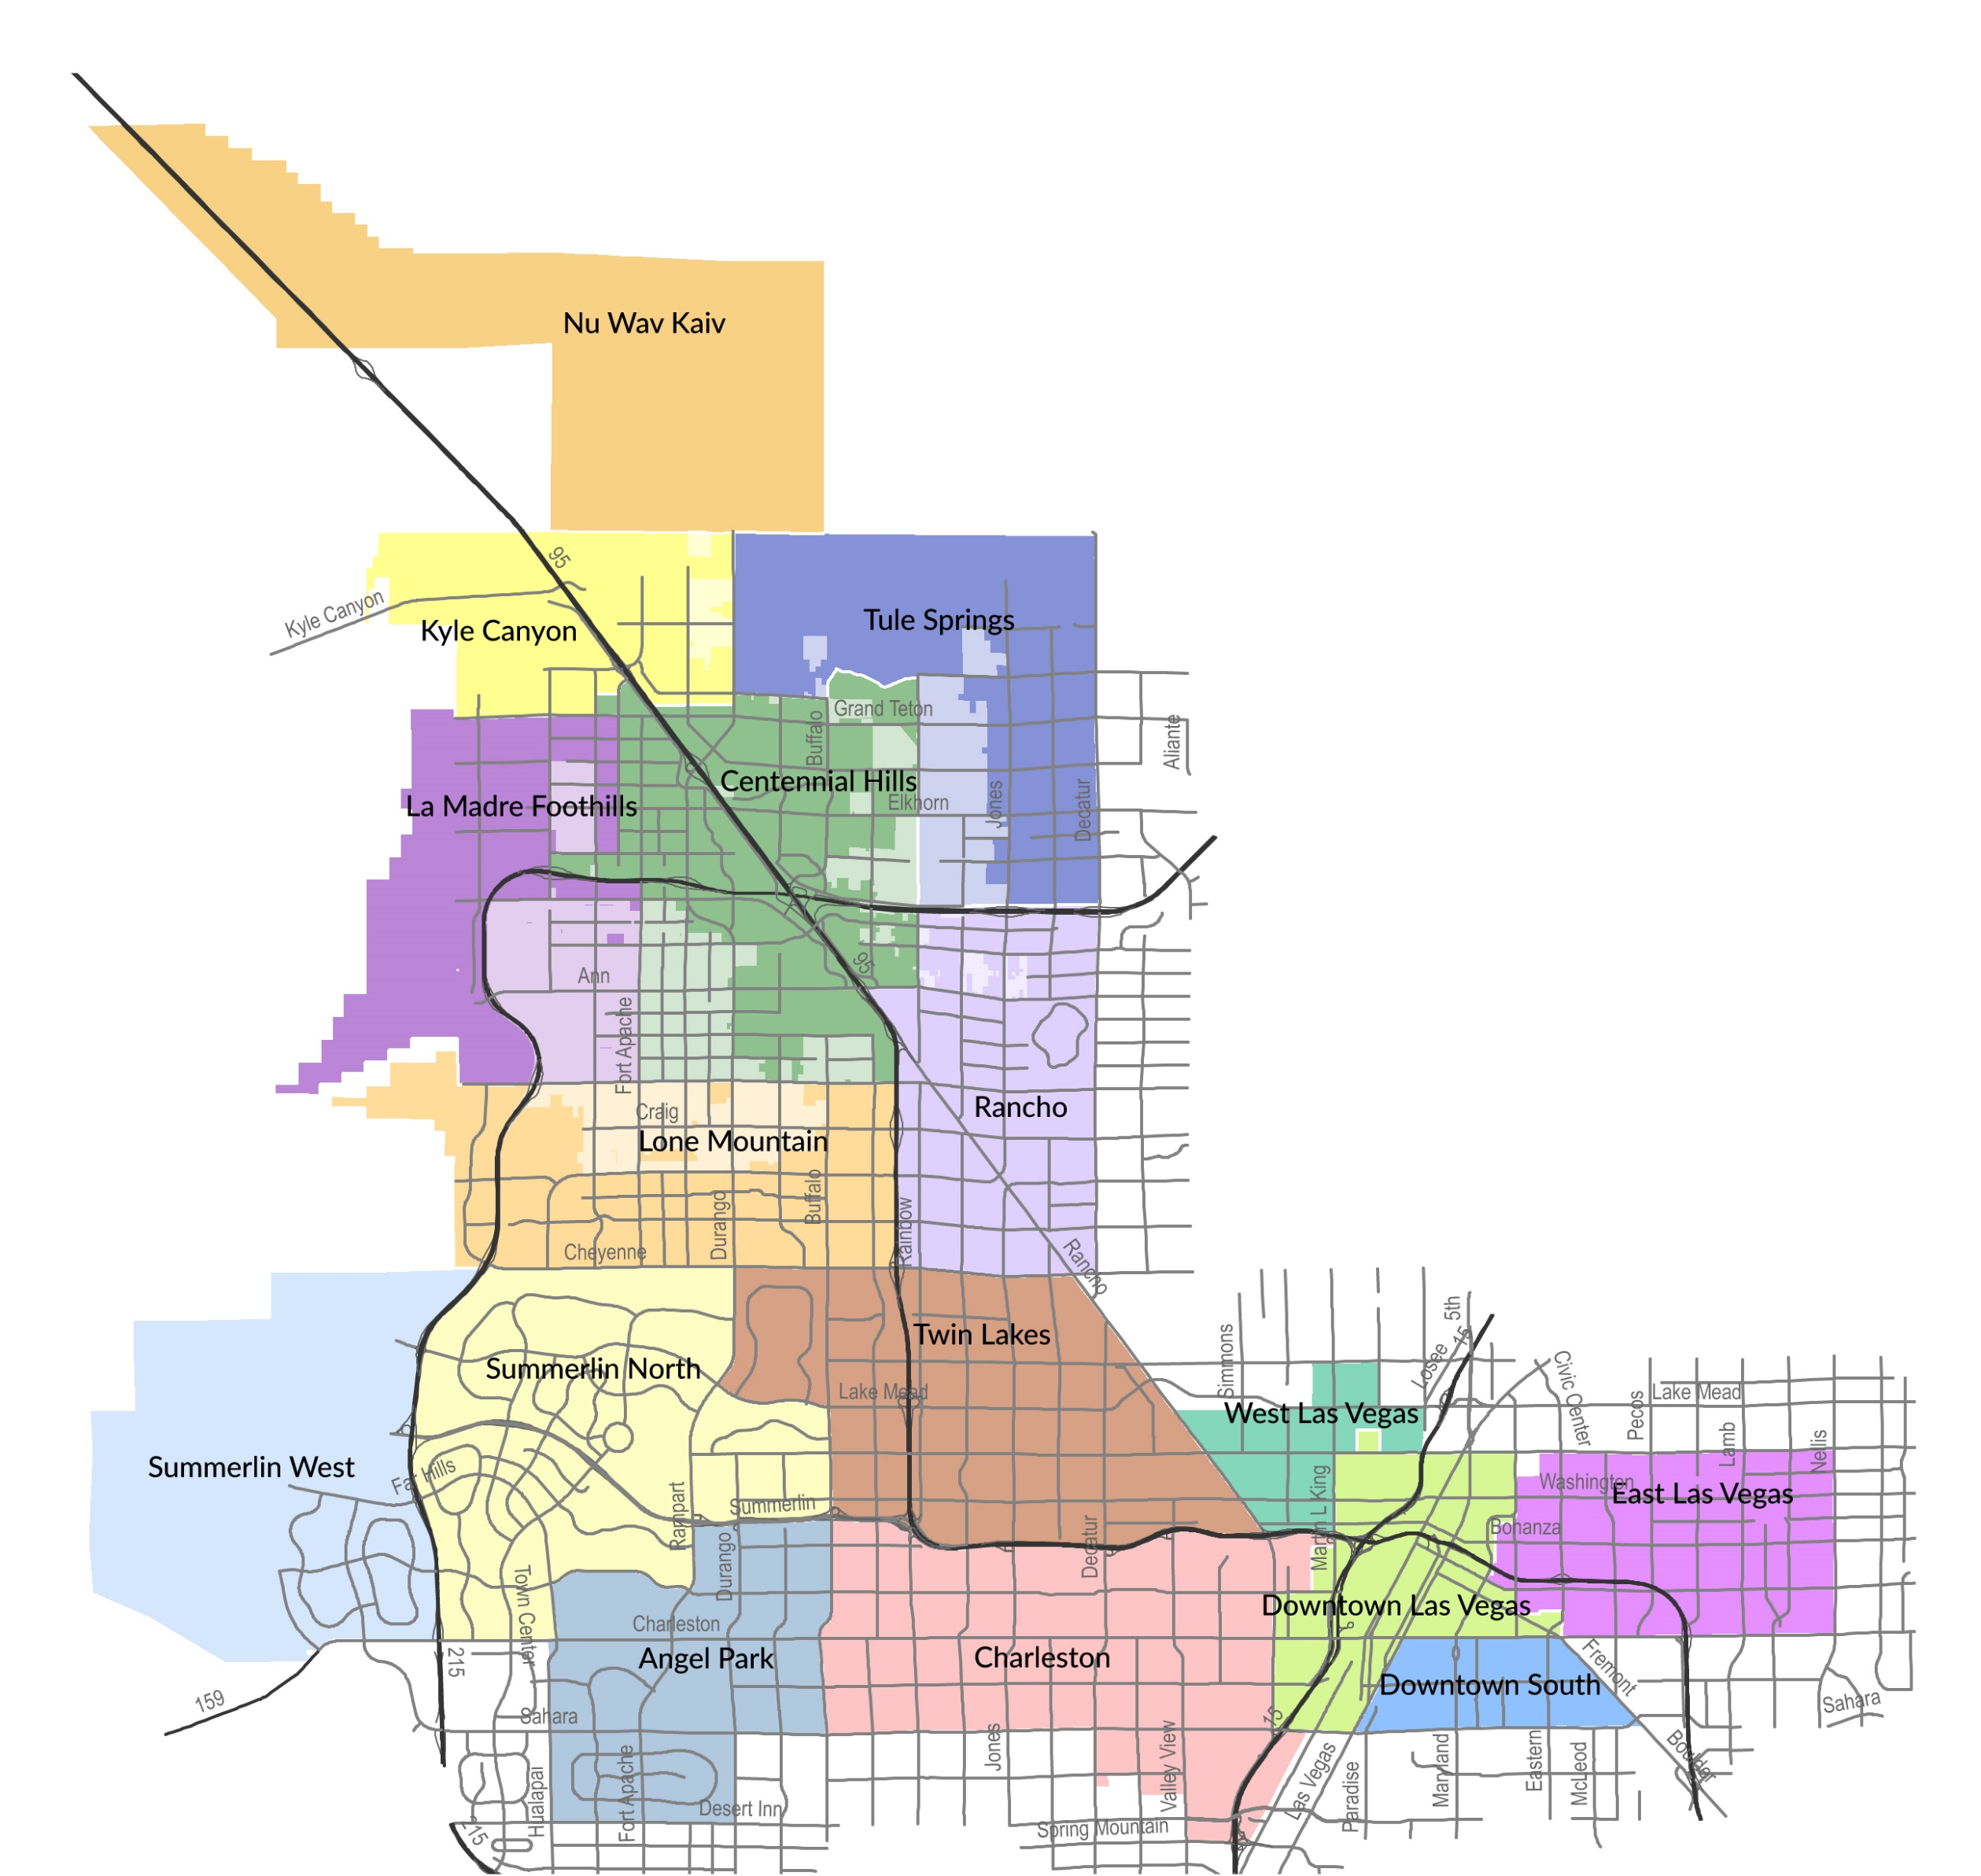
Areas of the City
16 unique areas of our community, each comprised of neighborhoods that can build identity and a sense of place that:
Are safe
Have parks, community centers, and schools
Are affordable and well served by businesses and public infrastructure
Conserve resources and water
Preserve neighborhoods
Have jobs and employment opportunities
Are well connected by streets, trails, bike lanes, and transit
….all in a manner that’s equitable, innovative, health-minded, livable, resilient; whether tomorrow, in the months or years ahead, or by 2050.

Slide 23
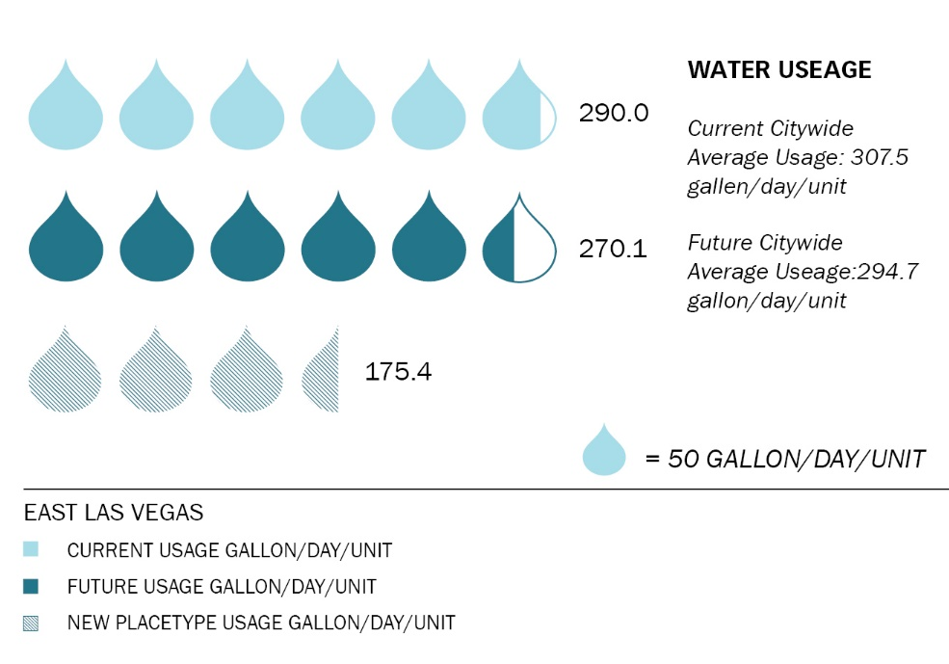
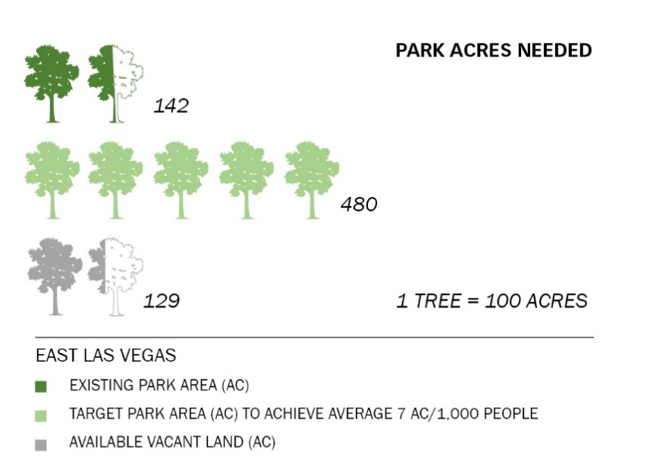
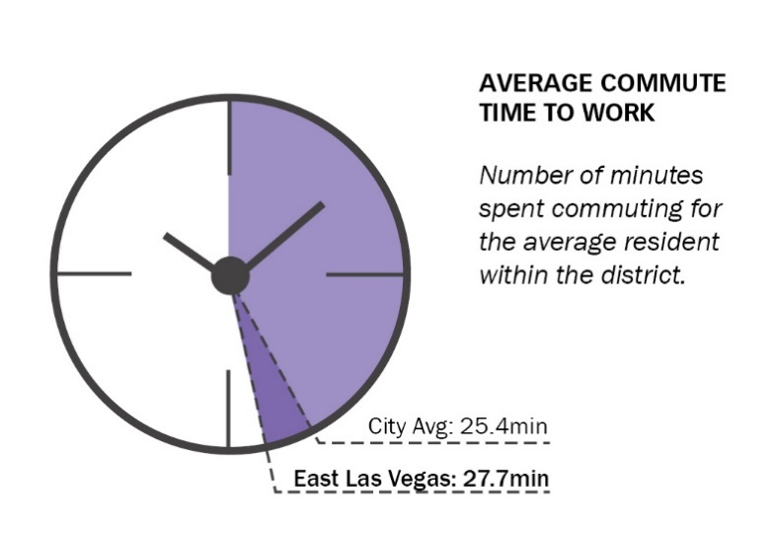

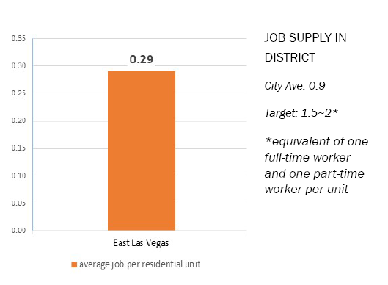

east las Vegas
JOB SUPPLY

Slide 24
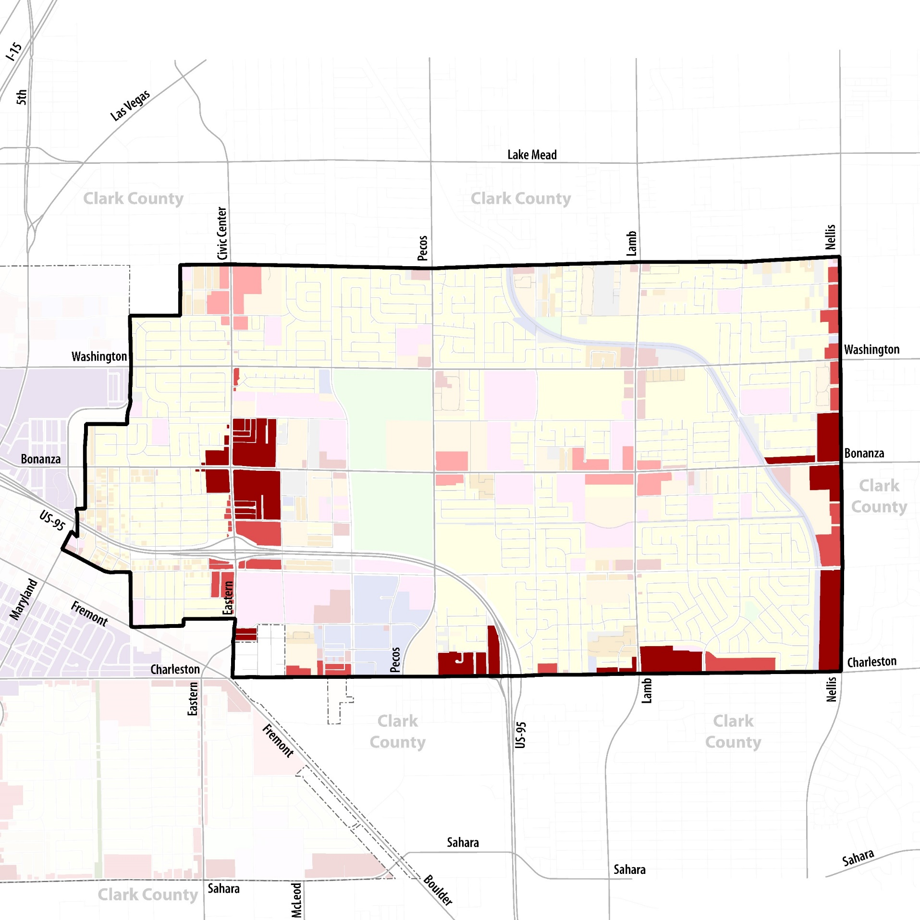
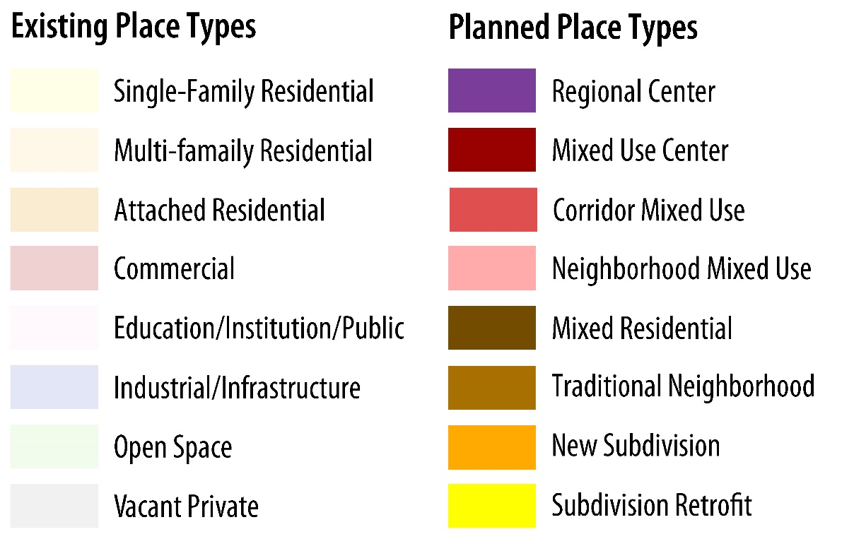
east las Vegas
Corridor Mixed Use
Mixed Use Center
Neighborhood Mixed Use
Mixed Residential
Traditional Neighborhood

Slide 25
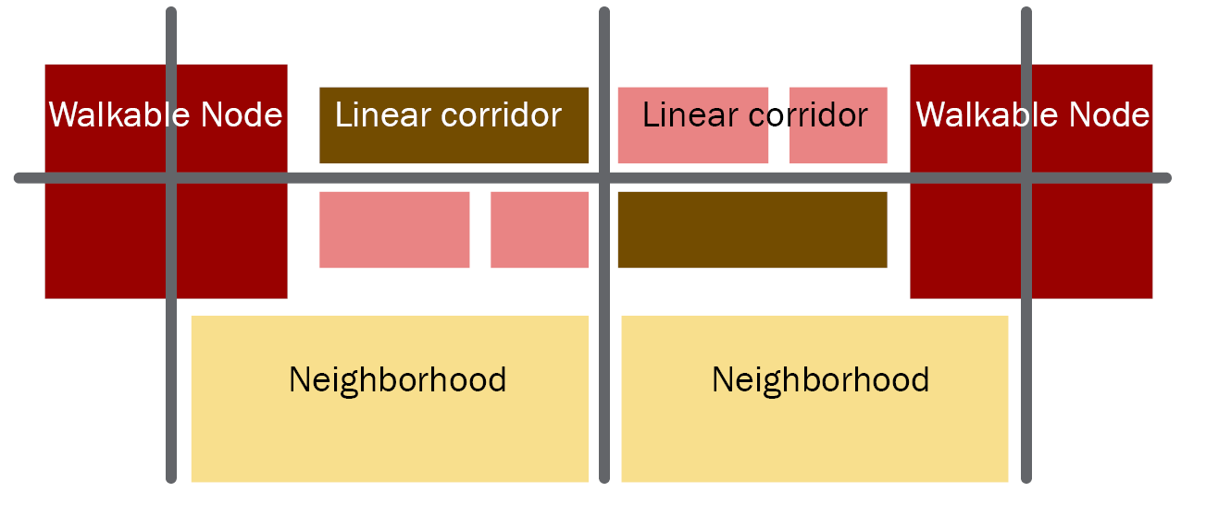
2050 general plan & future land Use
Infill and redevelopment
Prioritize transit corridors – present and future
  Mixed-Use Nodes
  Corridor Connectors
Expect less change to existing, established neighborhoods
2050 General Plan
  Establishes current and future land use
  Zoning conforms to the land use
  Official Zoning Map remains in effect until changed
Notes:
***Note for Silverstone- we’re not changing underlying plan categories for an area like Silverstone or area / MPC.

Slide 26
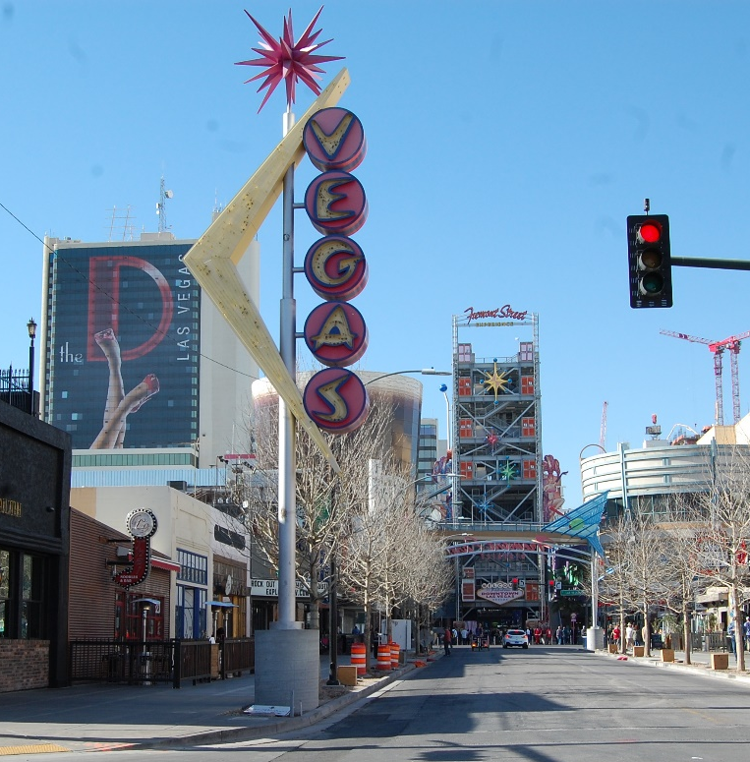
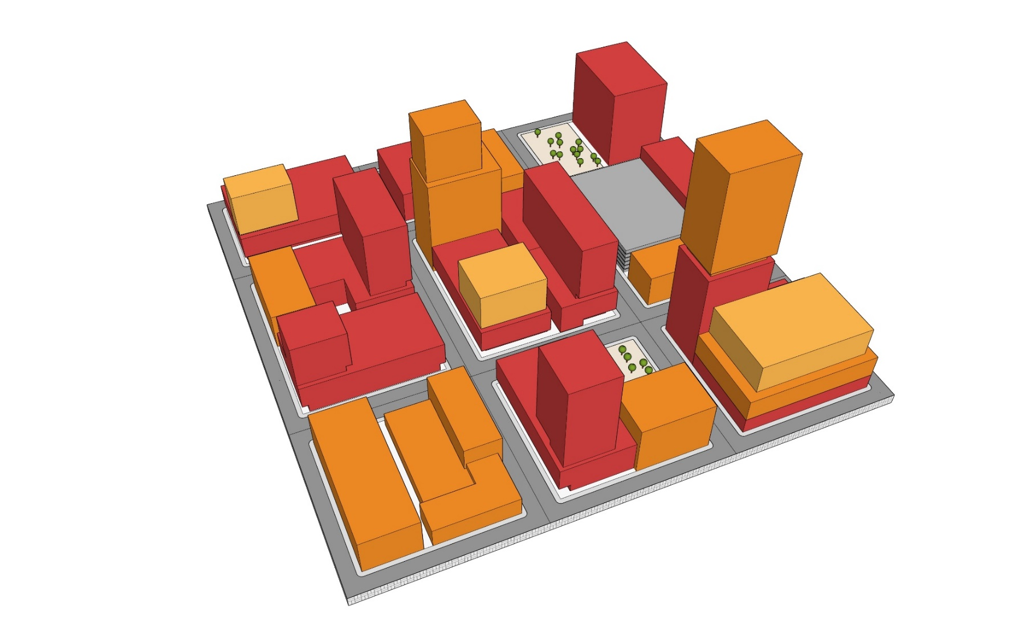
future land Use placetypes
Regional Centers
  Downtown Las Vegas (FBC)
  Centennial Hills Town Center (TC)

Slide 27
future land Use placetypes
Corridor Mixed Use (TOC-1 / TOC-2)

Slide 28
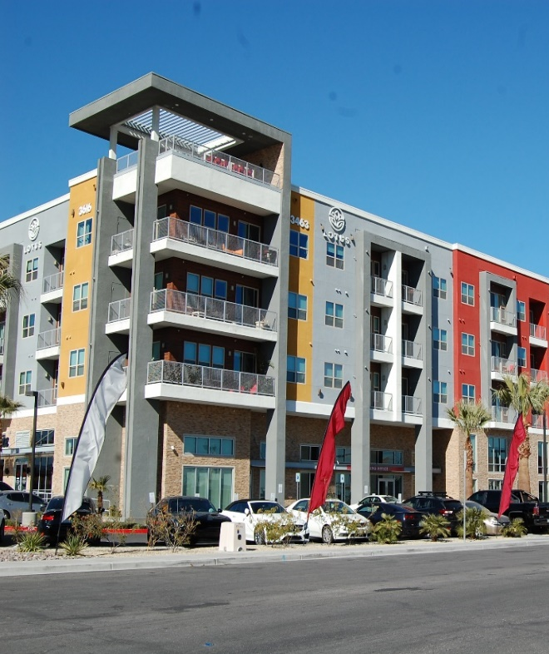
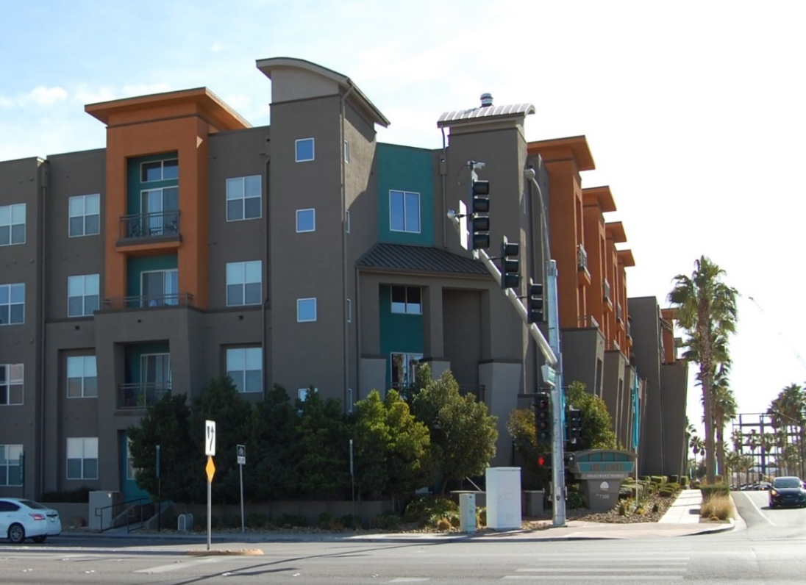
future land Use placetypes
Mixed Use Center (TOD-1 / TOD-2)

Slide 29
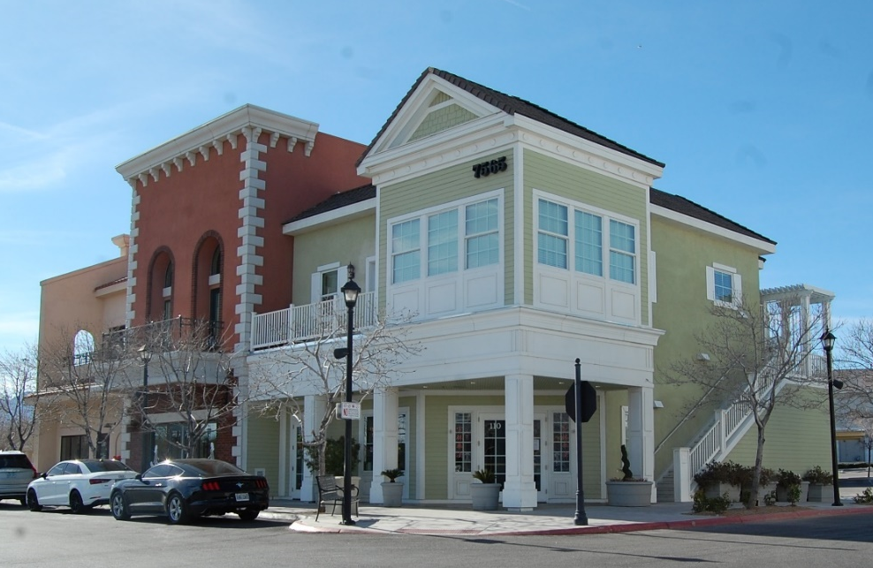
future land Use placetypes
Neighborhood Centers (NMXU)

Slide 30
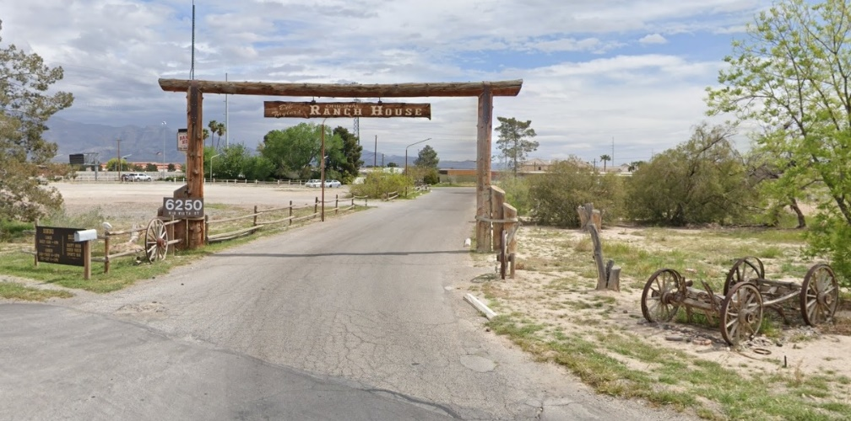
Existing land Use placetypes
Existing Types (All other General Plan categories)
  Mixed Residential
  Traditional Neighborhoods
  Subdivision retrofits
  New subdivisions
  Rural Preservation

Slide 31
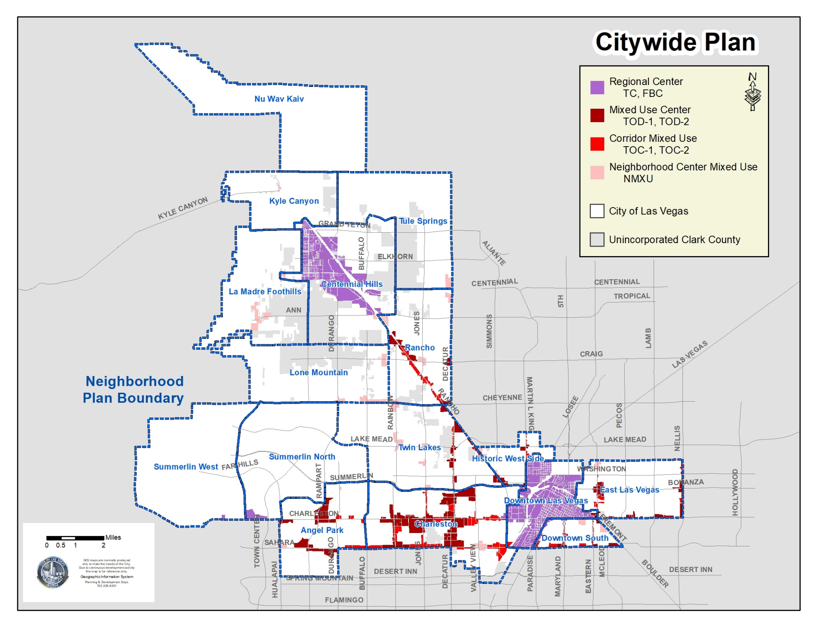
2050 general plan & future land Use

Slide 32
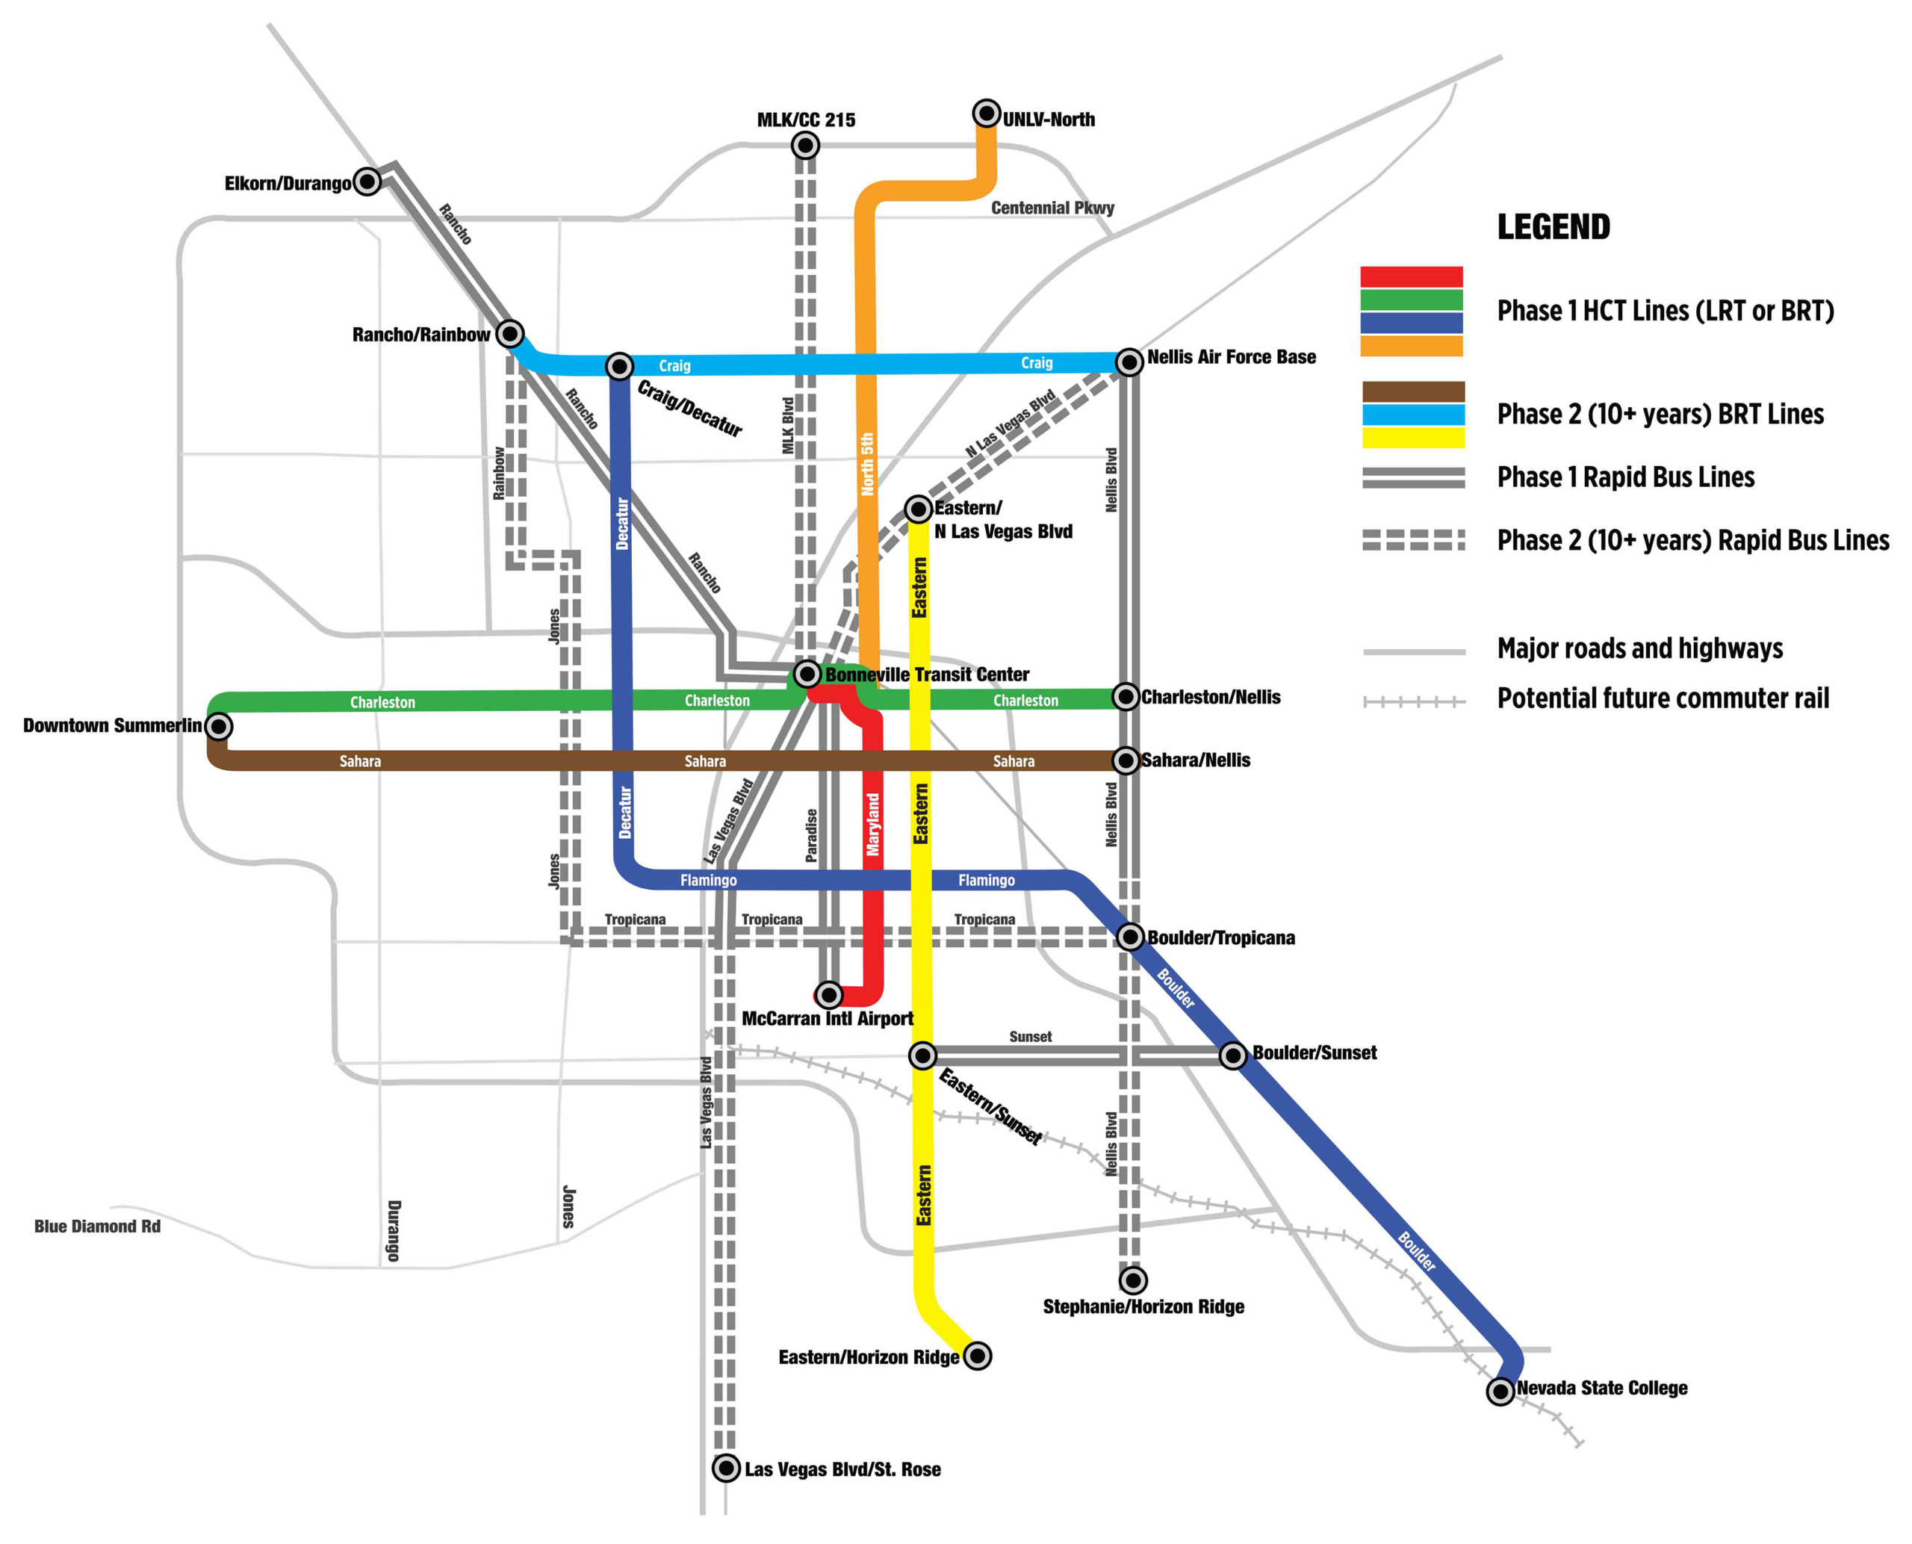

Slide 33
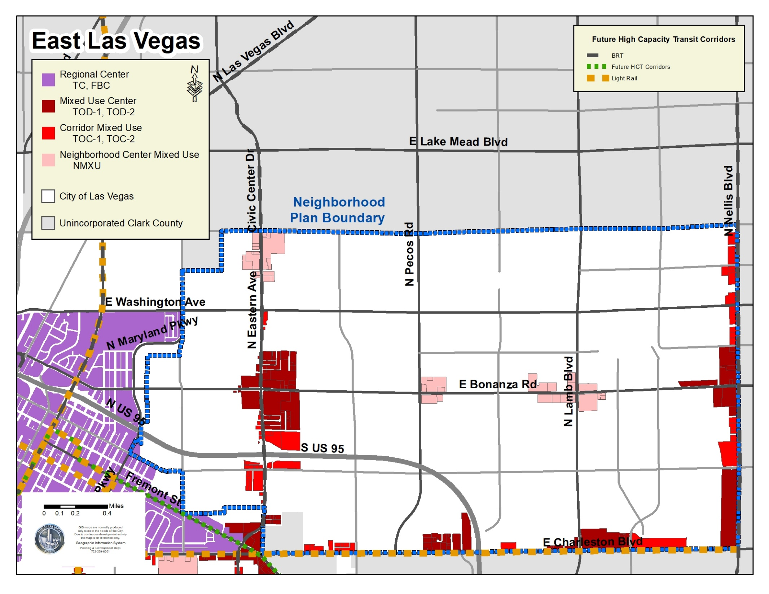
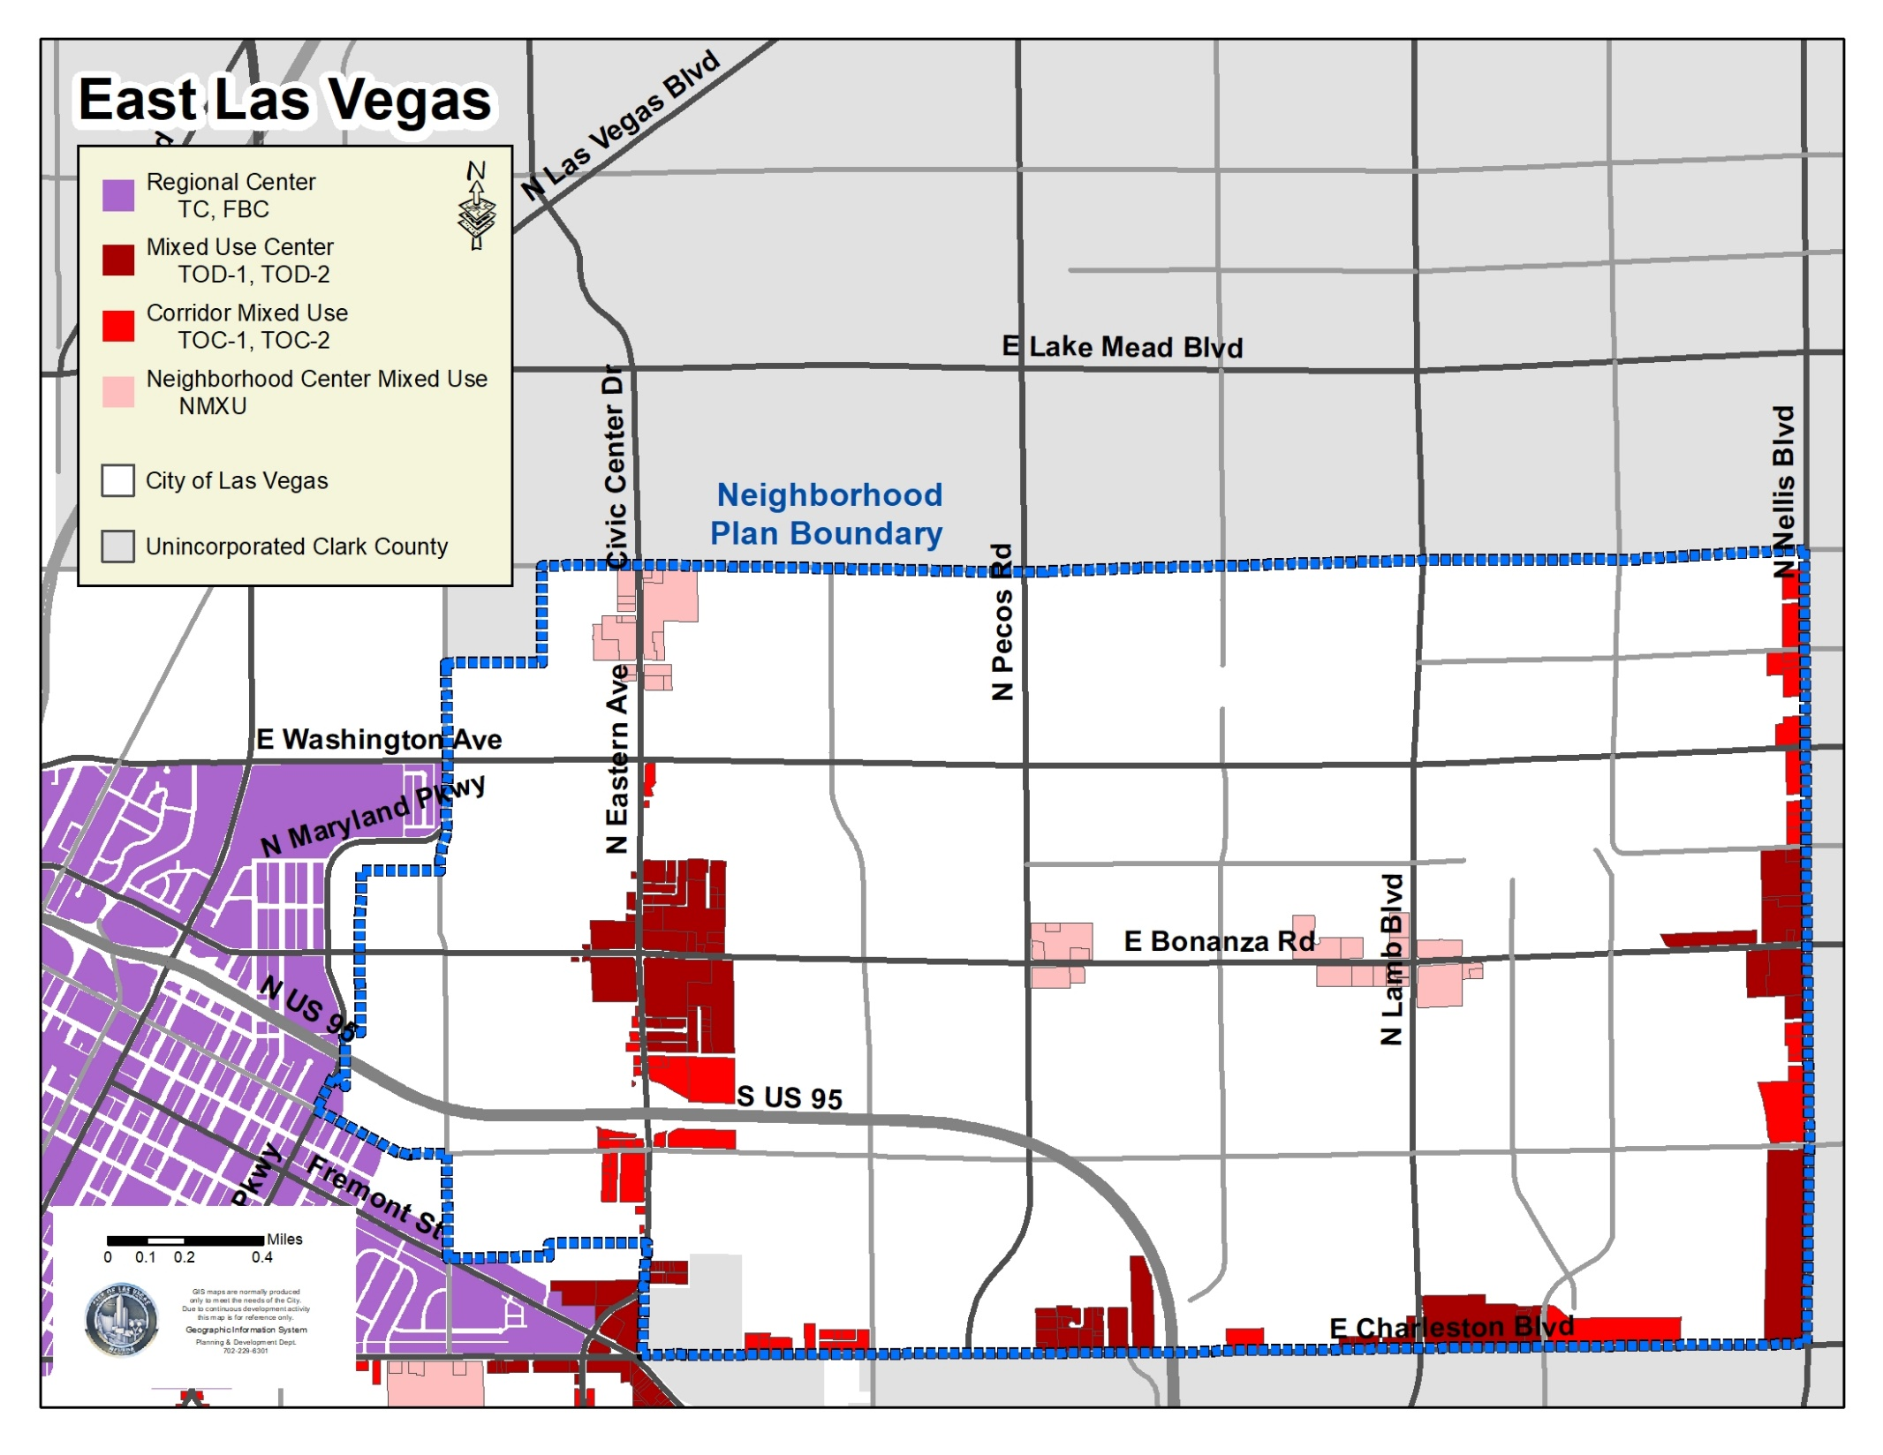
2050 general plan & future land Use

Slide 34
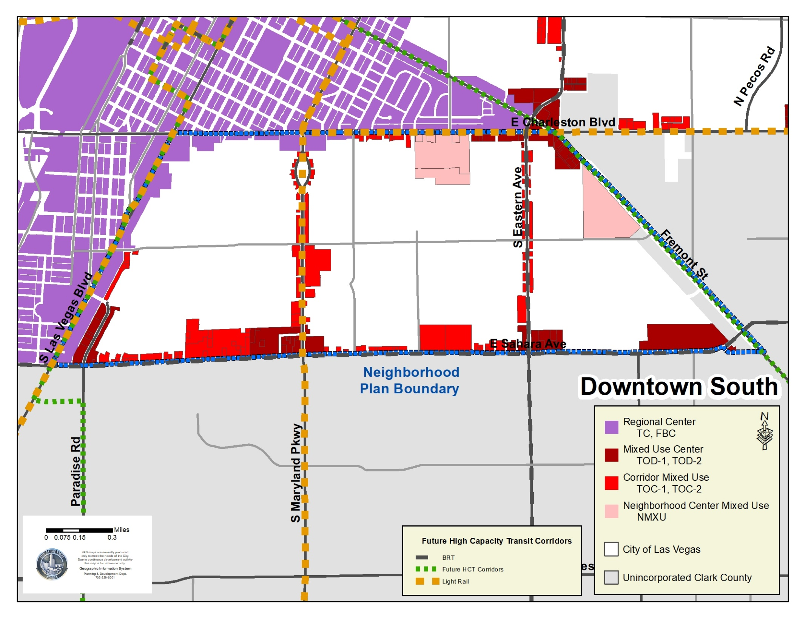
2050 general plan & future land Use

Slide 35
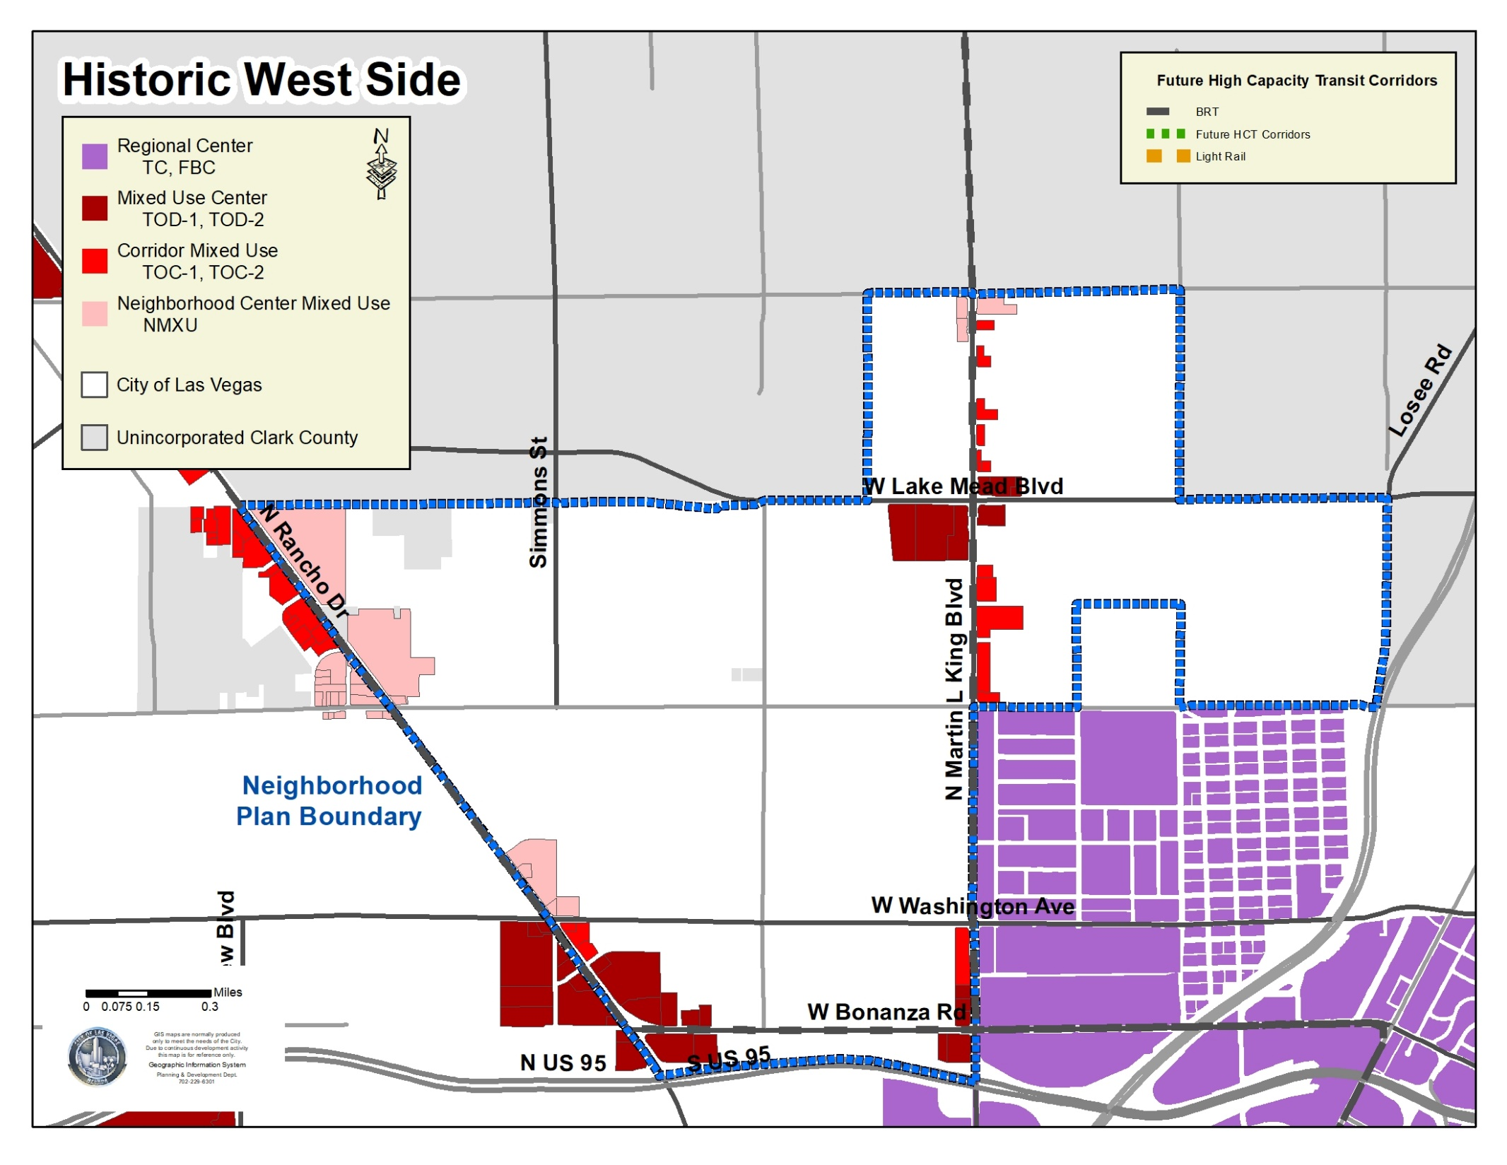
2050 general plan & future land Use

Slide 36
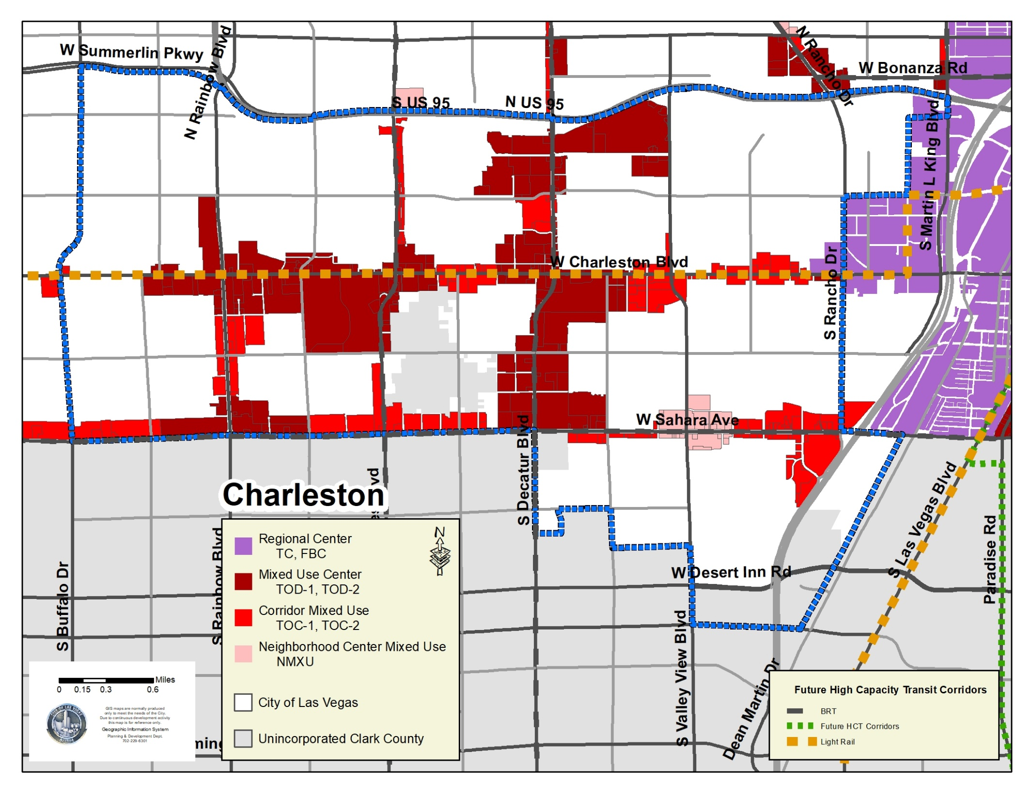
2050 general plan & future land Use

Slide 37
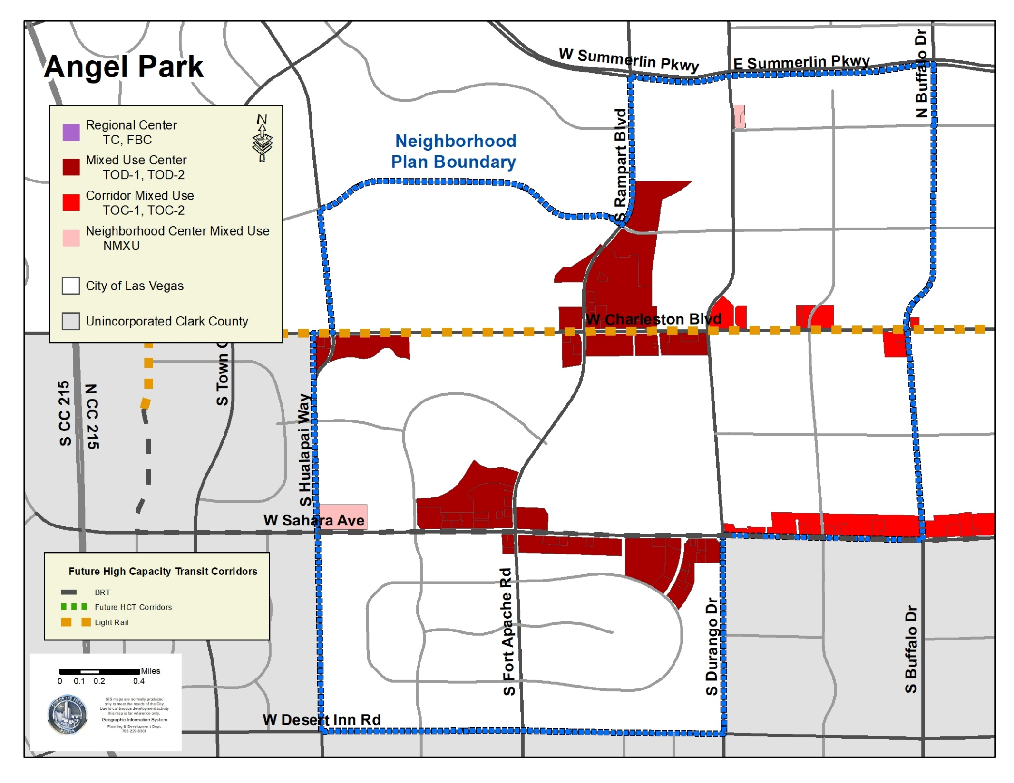
2050 general plan & future land Use

Slide 38
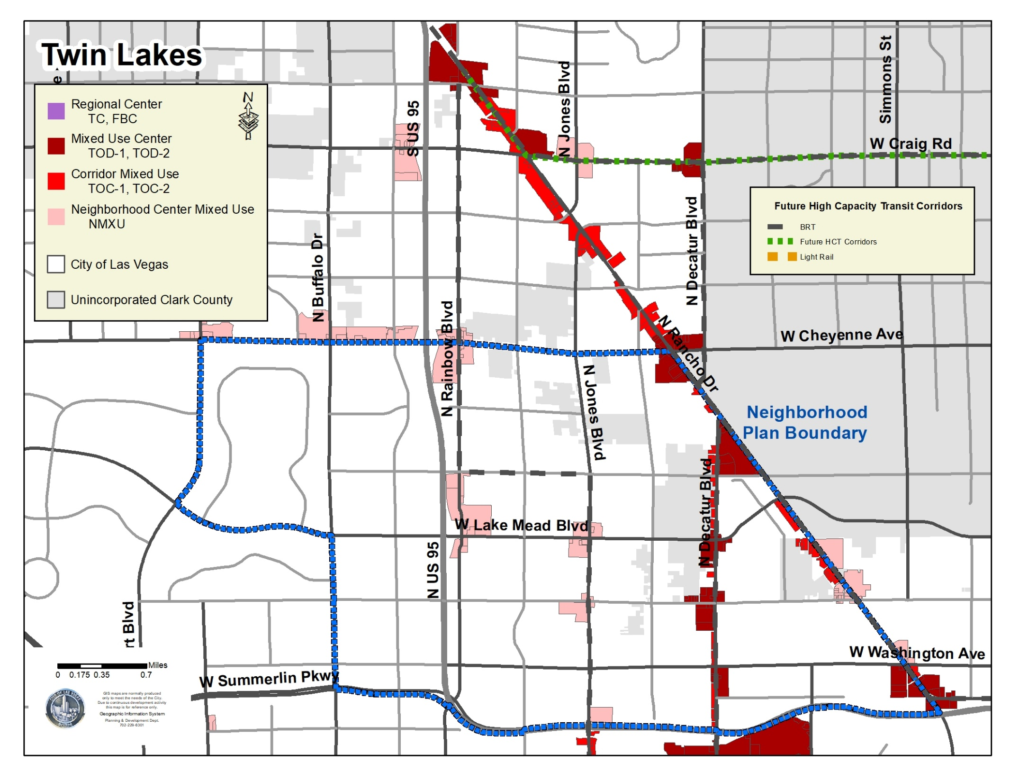
2050 general plan & future land Use

Slide 39
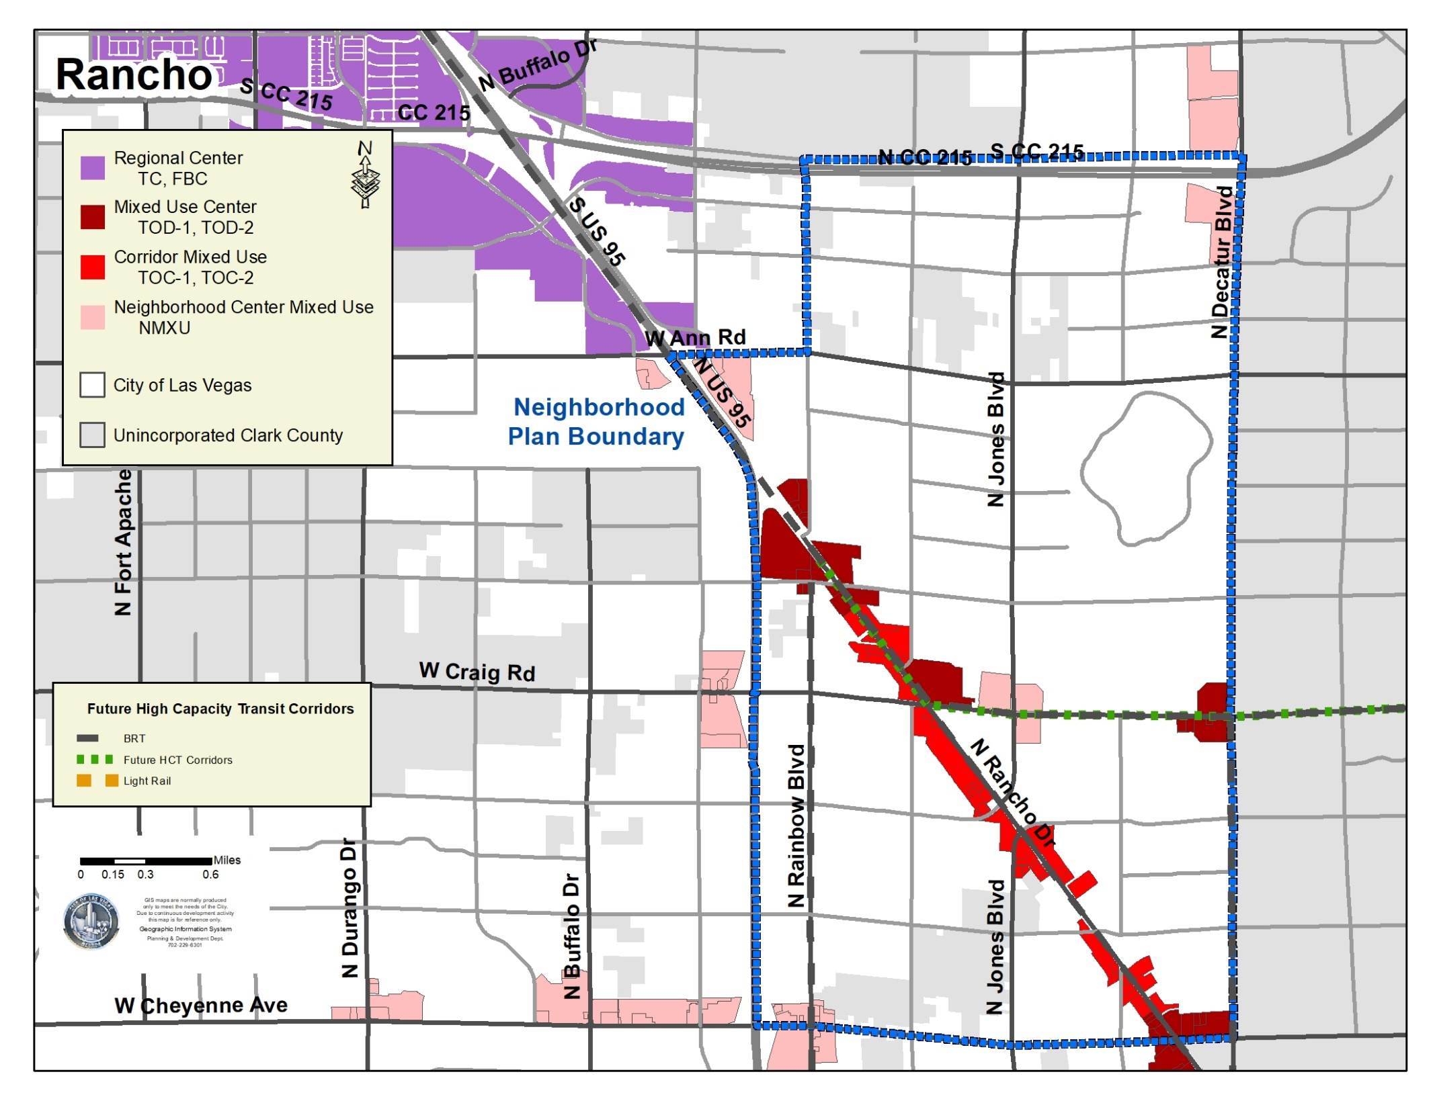

2050 general plan & future land Use

Slide 40

2050 general plan & future land Use

Slide 41

2050 general plan & future land Use
Notes:
Prioritize transit corridors – present and future
Mixed-Use Nodes
Corridor Connectors
Future Neighborhood area plans will provide recommendations for grey areas

Slide 42




Land use & Environment
Environment
  Natural Features
  Urban Forestry
  Parks
  Park Connectivity
  Food and Urban Agriculture
  Environmental Justice
Notes:
Natural Features
No net loss of species and landforms
Use of SNPLMA
Urban Forestry
100,000 native and adaptive trees that increase the canopy
Parks and Connectivity
Increase park acreage to 7 acres / 1,000 residents
> 85% dwelling units within walk of park and trail
Food and Urban Agriculture
No food deserts and reduce food swamps by increasing healthy food access
Ensure supply chain security and redundancy
Provide accessibility to community gardens and increase allowable agricultural uses
Environmental Justice
AQI of 100 or better
No brownfields within the City
Reduce exposure and risk to low-income and minority communities
Improve stormwater pollution prevention efforts

Slide 43




Economy & workforce
Education
  Equitable Education
  Schools
Economy
  Economic and Workforce Development
  Redevelopment
  Public Finance
Housing
  Housing choice
  Homelessness

Slide 44


Systems & services
Transportation
  Complete Streets
  Transit
  Smart Systems
Resource Conservation
  Water
  Energy
  Waste
  Greenhouse Gas Emissions
Public Facilities and Services
  Public Facilities
  Public Health and Social Services
Safety
  Hazards
  Public Safety

Slide 45


Implementation
Tools
  City policies and regulations
  Major projects
  Partnerships and Collaboration
  Program and Service Delivery
  Legislative changes
Partnerships
Action plans
Fifty by ‘50 – Assessing outcomes
  2050 Master Plan website
  Reports to Planning Commission and City Council

Slide 46
Next steps
Adoption
  Planning Commission – 4.13.21
  City Council – 5.19.21
Zoning
  Summer / Fall 2021

Slide 47



A few common questions we’ve received
Has the City done something like this before?
  Yes: We’re doing it now in Downtown Las Vegas
    Downtown Las Vegas Masterplan was adopted
    Includes recommended improvements including UNLV School of Medicine, major street projects, Innovation district, new housing
    General Plan land use change (FBC)
    Adoption of zoning standards: Title 19.09 - Form-Based Code
    Rezoning for Las Vegas Medical District, Fremont East, Historic Westside

Slide 48




A few common questions we’ve received
Can you give us an idea of what new transit-oriented zoning for the land use placetypes would be like?
  Mix of residential and commercial uses
  Active street and ground floor
  Increased lot coverage
  Walkable and well-connected – close proximity to the street
  Parking maximums
  Appropriately sized and scaled for the location

Slide 49

A few common questions we’ve received
Are these corridors ready for the change the plan describes?
  The City is working collaboratively with RTC and Clark County on the Maryland Pkwy corridor
    Market readiness
    Workforce housing
    Focus area plans
    Transit project connecting Medical District, UNLV, Airport

Slide 50

Where can I get more information?
www.masterplan.vegas
www.imaginelvparks.com
EMAIL: masterplan@lasvegasnevada.gov

Slide 51
Questions from our audience
For our audience here at City Hall:
  Thank you for maintaining social distancing and continuing to wear your mask
  Write down any questions and provide them to City staff at the front
  If called upon, please state your name – we will repeat your question so everyone can hear
  We will attempt to answer as many general questions as possible
For our viewers online and on KCLV:
  Submit your questions to socialmedia@lasvegasnevada.gov
If we run out of time and we don’t answer your question:
  Please ask us at the conclusion of the meeting – we want to get a record and provide a response
  Emailed questions will be responded to over the next week

Slide 52
2050 general plan & future land Use
Notes:
Prioritize transit corridors – present and future
Mixed-Use Nodes
Corridor Connectors
Future Neighborhood area plans will provide recommendations for grey areas

Slide 53
2050 general plan & future land Use
Notes:
Prioritize transit corridors – present and future
Mixed-Use Nodes
Corridor Connectors
Future Neighborhood area plans will provide recommendations for grey areas

Slide 54
2050 general plan & future land Use
Notes:
Prioritize transit corridors – present and future
Mixed-Use Nodes
Corridor Connectors
Future Neighborhood area plans will provide recommendations for grey areas

Slide 55
2050 general plan & future land Use
Notes:
Prioritize transit corridors – present and future
Mixed-Use Nodes
Corridor Connectors
Future Neighborhood area plans will provide recommendations for grey areas

Slide 56
2050 general plan & future land Use
Notes:
Prioritize transit corridors – present and future
Mixed-Use Nodes
Corridor Connectors
Future Neighborhood area plans will provide recommendations for grey areas

Slide 57
2050 general plan & future land Use
Notes:
Prioritize transit corridors – present and future
Mixed-Use Nodes
Corridor Connectors
Future Neighborhood area plans will provide recommendations for grey areas

Slide 58
2050 general plan & future land Use
Notes:
Prioritize transit corridors – present and future
Mixed-Use Nodes
Corridor Connectors
Future Neighborhood area plans will provide recommendations for grey areas

Slide 59
2050 general plan & future land Use
Notes:
Prioritize transit corridors – present and future
Mixed-Use Nodes
Corridor Connectors
Future Neighborhood area plans will provide recommendations for grey areas

