Slide 1
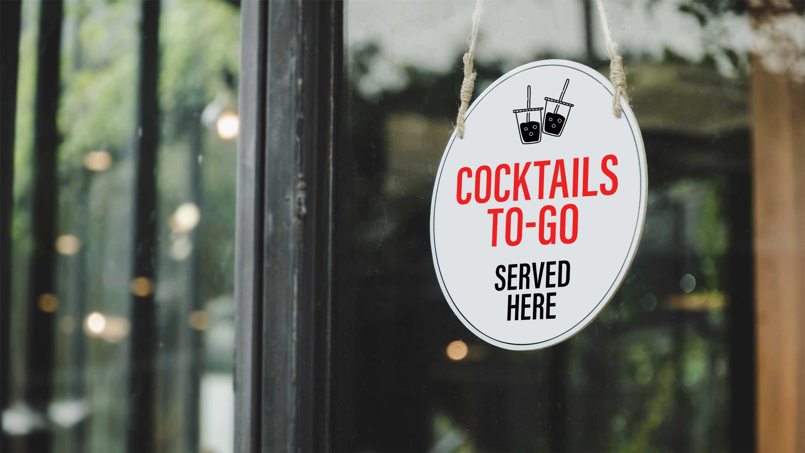
Proposed Alcohol To-Go Ordinance
Stakeholder Meeting
Proposed Amendments to LVMC Chapter 6.50
Presented by:
City of Las Vegas Business Licensing

Slide 2
Why Is This Being Proposed?
AB 375 authorized local governments to allow restaurants to sell alcoholic beverages, including mixed drinks, for off-premise consumption when sold with a meal.
Draft Establishes:
Packaging,
Delivery,
Age verification, and
Recordkeeping requirements.
Creates an endorsement that may be added to qualifying existing licenses.

Slide 3
Who Is Affected?
      Restaurants with on-premise alcohol licenses
      Package liquor stores
      Beer/Wine off-premise establishments
      Brewpubs
      Alcohol delivery support services

Slide 4
Current Code vs. Proposed Changes
  Existing off-premise alcohol sales authority remains unchanged
  Authorizes eligible restaurants to sell mixed drinks to-go in connection with a meal.
  Creates an endorsement for qualifying alcohol to-go activities.
  Creates dedicated delivery restriction section (6.50.110).
  Adds packaging, recordkeeping, and operational standards.

Slide 5
Endorsement Requirement
  An endorsement is required for alcohol sales involving:
  Delivery
  Curbside pickup
  Customer pickup
  Applies to existing off-premise retailers and eligible restaurants.

Slide 6
New Opportunity for Restaurants
Eligible restaurants may obtain an endorsement to sell mixed drinks to-go in connection with a meal.
Authorized methods include:
      Customer pickup,
      Curbside pickup, or
      Delivery.

Slide 7
Packaging Requirements
  Restaurant alcohol-to-go must be:
  Original manufacturer-sealed container; or
  Tamper-evident container with secure lid/cap and unbroken seal
  All packaging must comply with State law requirements.

Slide 8
Delivery Requirements
  Age verification required
  Recipient must be 21 years of age or older
  No deliveries to nonrestricted gaming locations
  Delivery records required
  Applicable City and State law requirements remain in effect.

Slide 9
Recordkeeping Requirements
    Maintain records including:
    Products sold
    Customer and recipient information
    Identification verification information
    Delivery date and time
    Delivery personnel information

Slide 10
Alcohol Delivery Support Services
  Requirements include:
  Minimum driver age requirements
  Alcohol awareness training
  ID verification procedures
  Refusal procedures for intoxicated recipients
  Background checks
  Compliance with NRS Chapter 369

Slide 11
Proposed Timeline
  Business Impact Solicitation (BIS): May 26 – June 25, 2026
  Stakeholder Meeting #1: June 15, 2026
  Stakeholder Meeting #2: June 23, 2026
  Review stakeholder feedback and consider revisions
  Proceed through process
  Tentative Timeline:
    City Council Introduction: 8/5/2026
    Recommending Committee: 8/17/2026
    Second Reading: 8/19/2026
    Potential Adoption: 9/02/2026

Slide 12
Frequently Asked Questions
  Q: Is this a new alcohol license?
  A: No, it is an endorsement. The fee for the endorsement is $500 semi-annually.
  Q: Can restaurants sell alcohol without a meal?
  A: No.
  Q: Can package liquor stores continue delivery and pickup sales?
  A: Yes, subject to endorsement requirements.
  Q: Can restaurants manufacture alcoholic beverages under this endorsement?
  A: No.
  Q: What is the primary change for restaurants?
  A. Eligible restaurants may obtain an endorsement to sell mixed drinks to-go when sold in connection with a meal.

